Slide 1
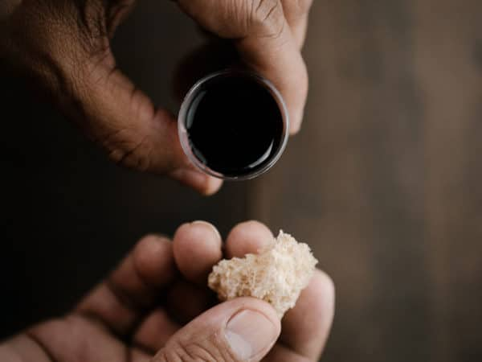
Prelude
He leadeth me:
O blessed thought!
Welcome

Slide 2
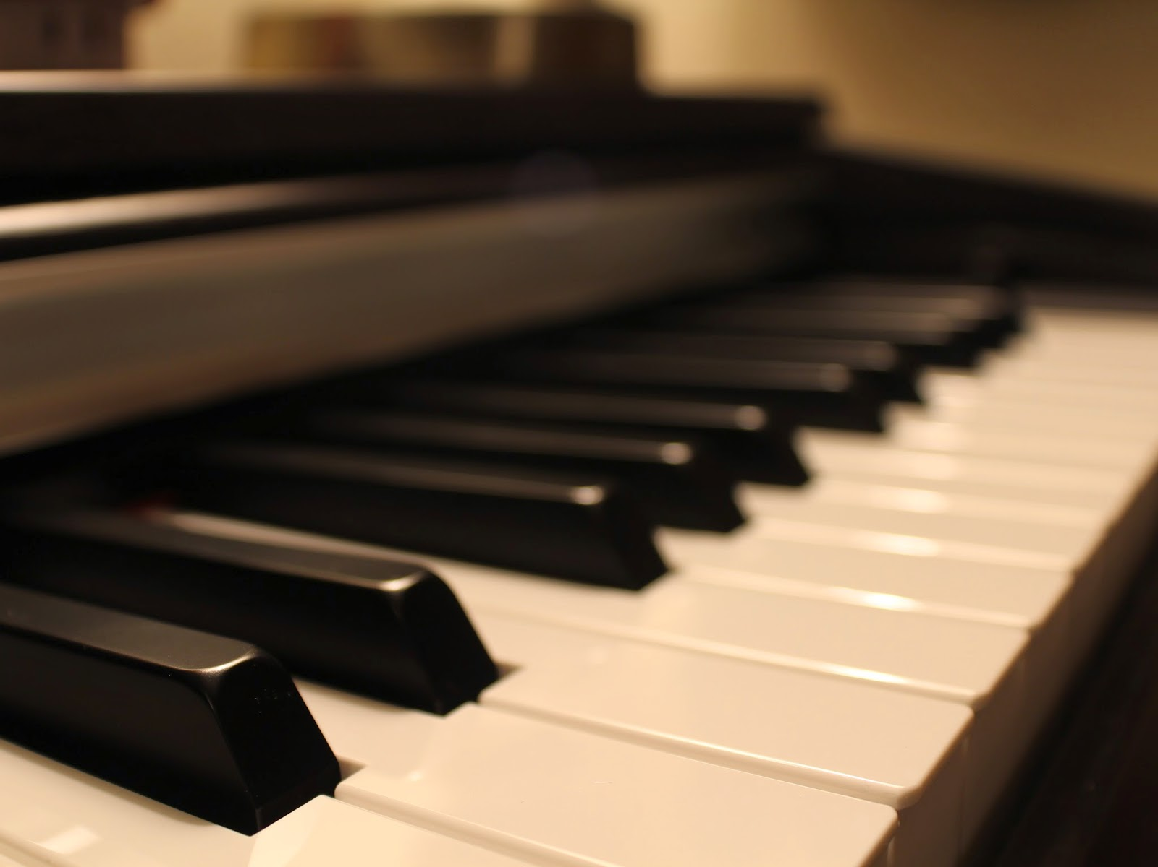
Ministry of Music: Summer Dream

Slide 3
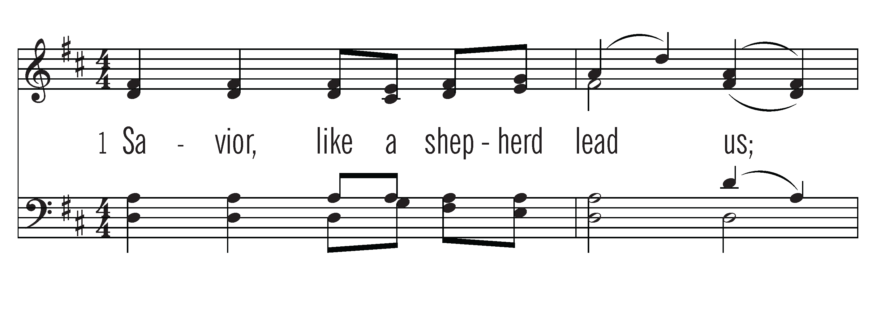
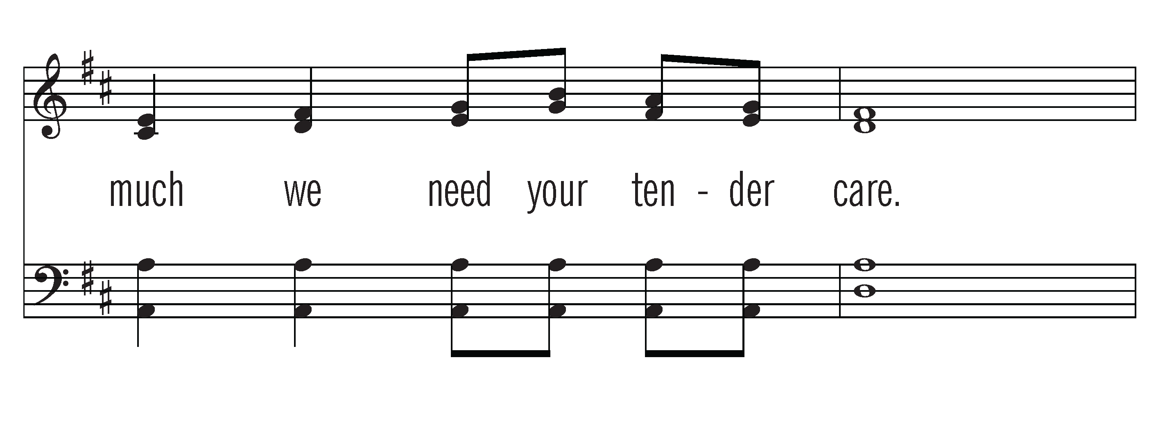

Slide 4
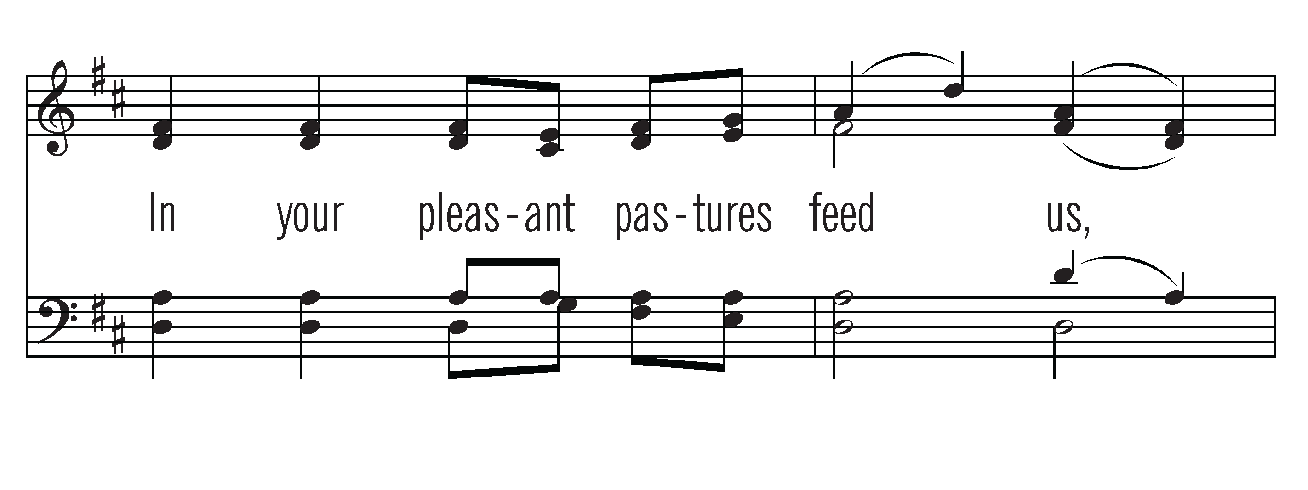
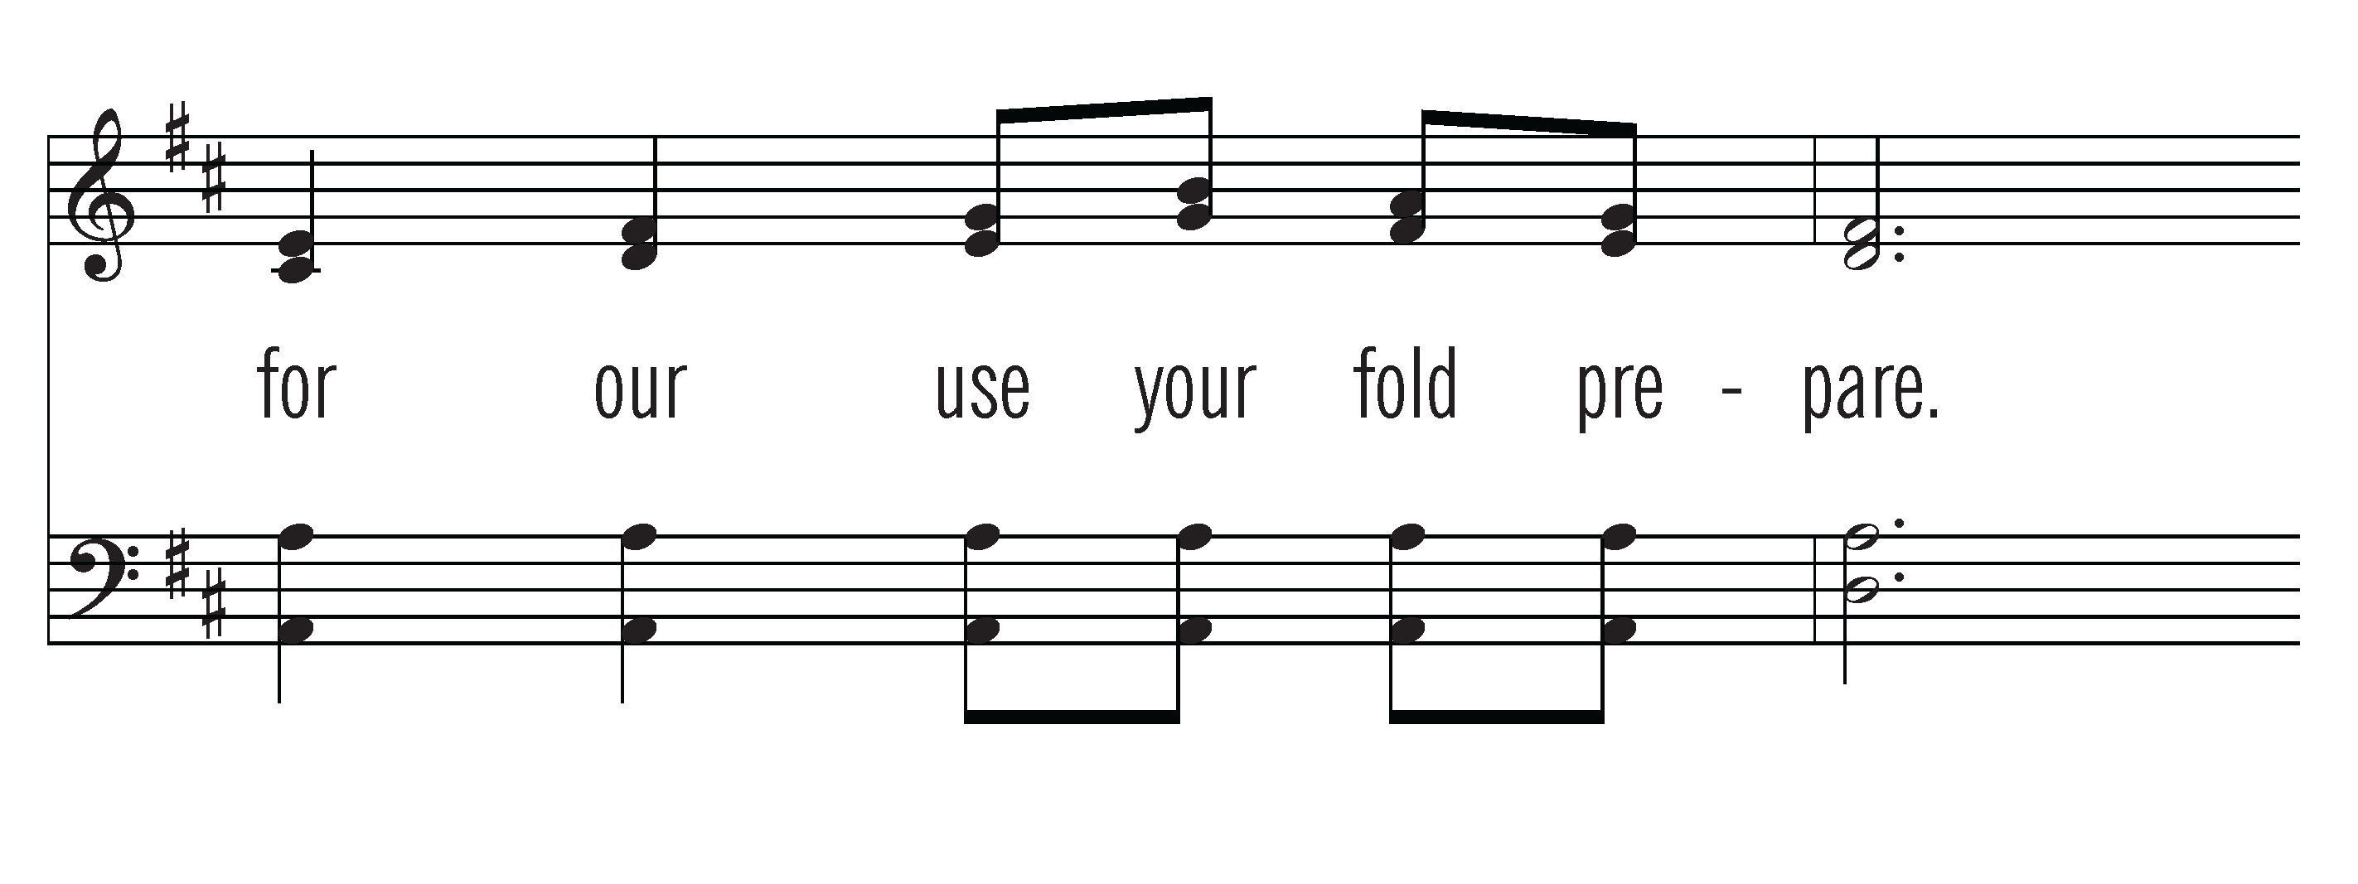

Slide 5
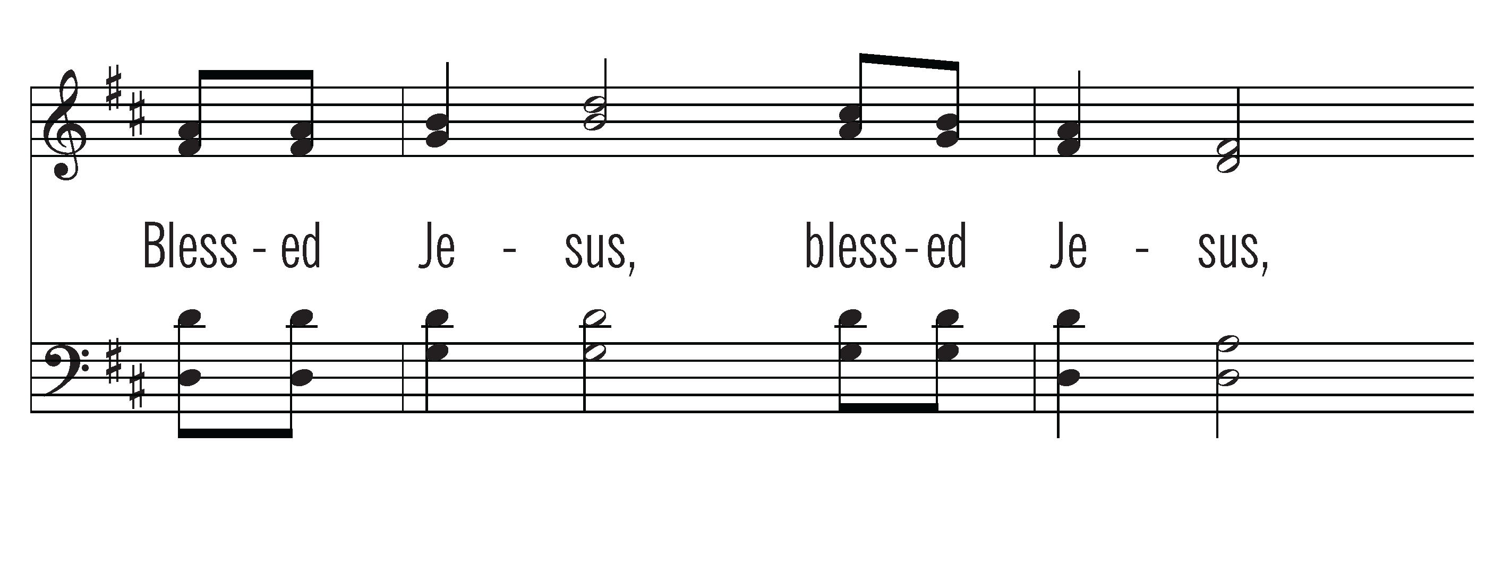
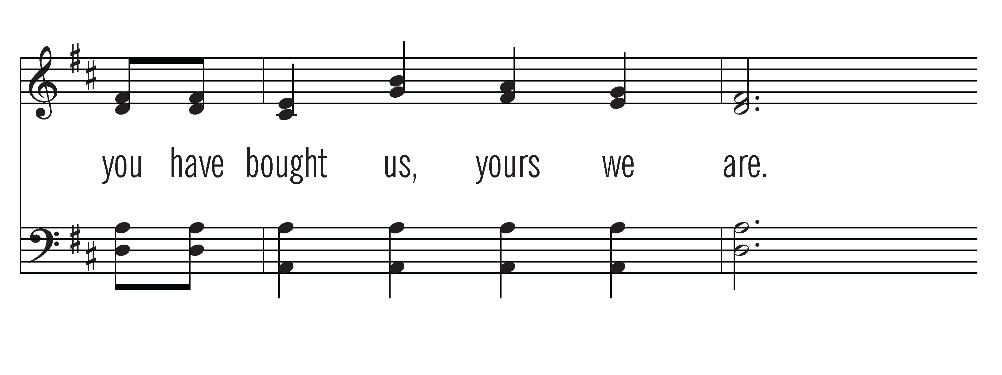

Slide 6

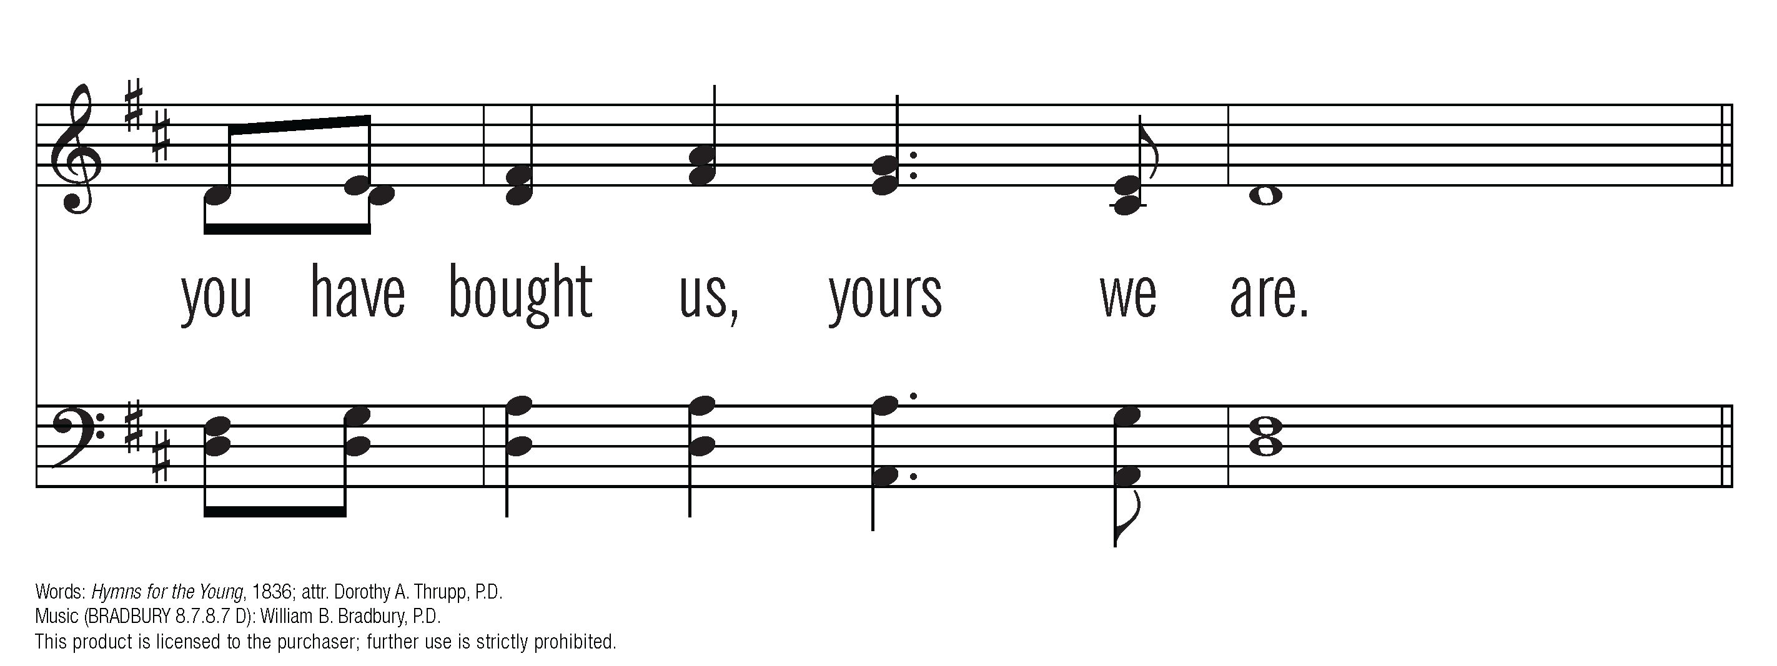
CCLI #678905

Slide 7
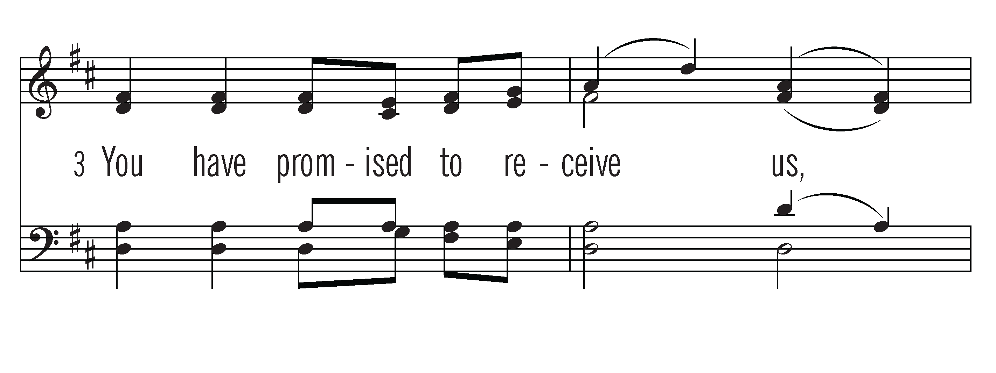
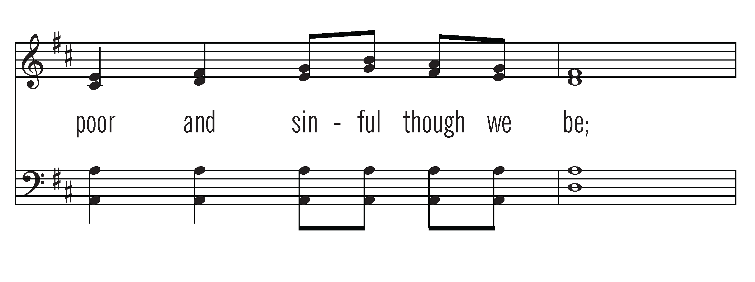

Slide 8
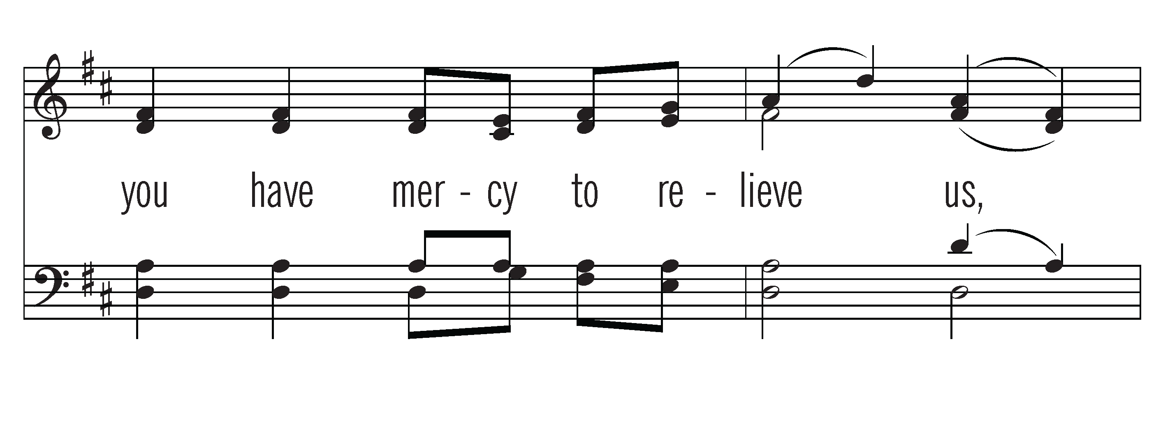
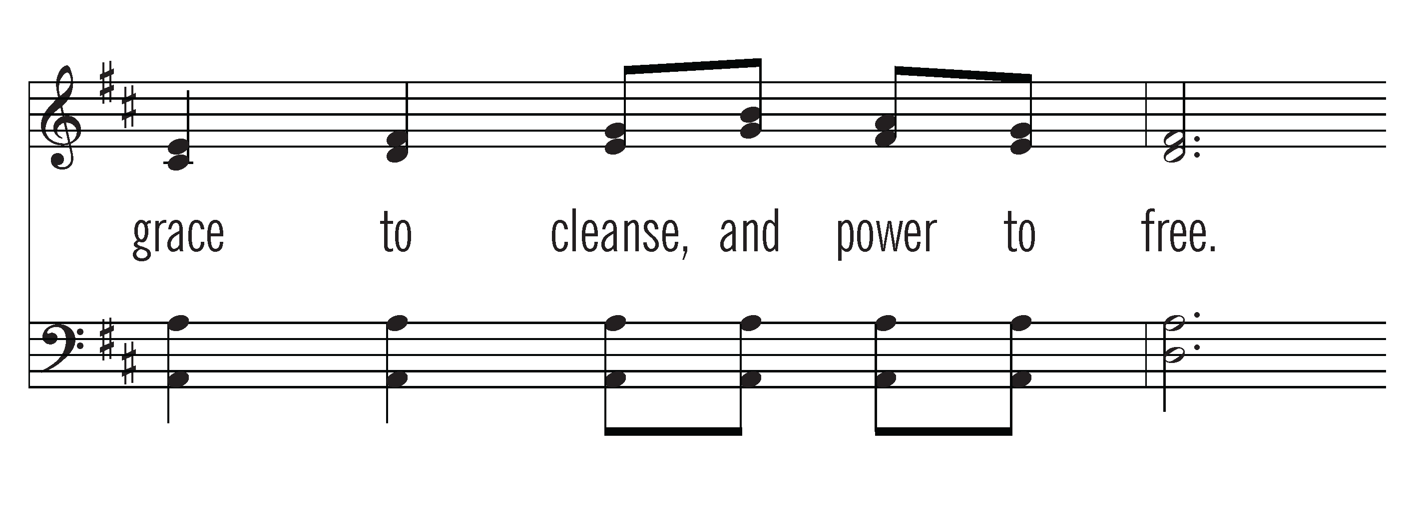

Slide 9
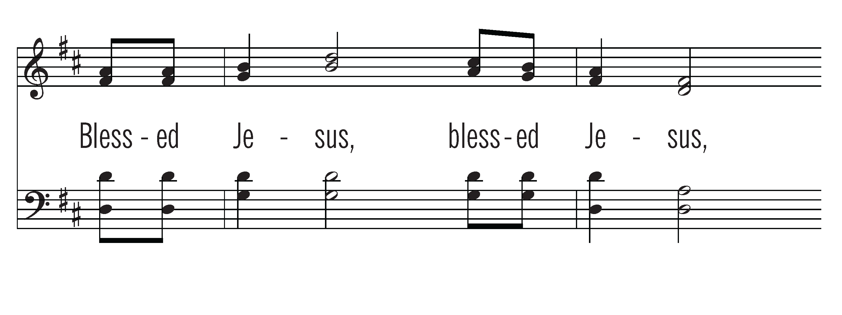
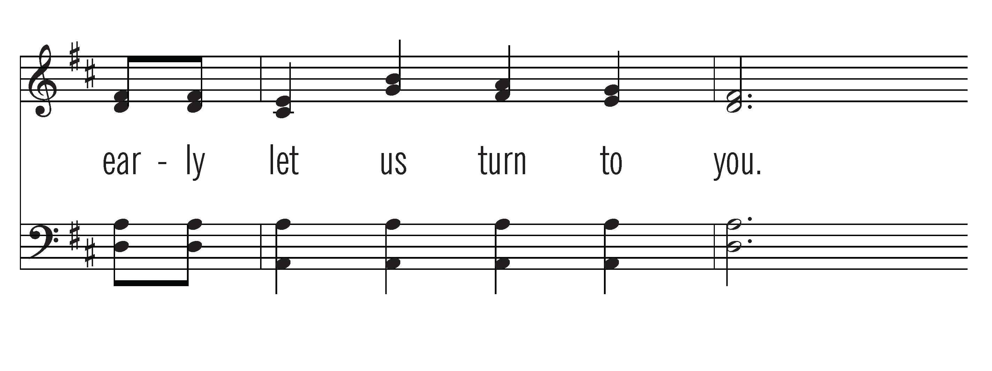

Slide 10
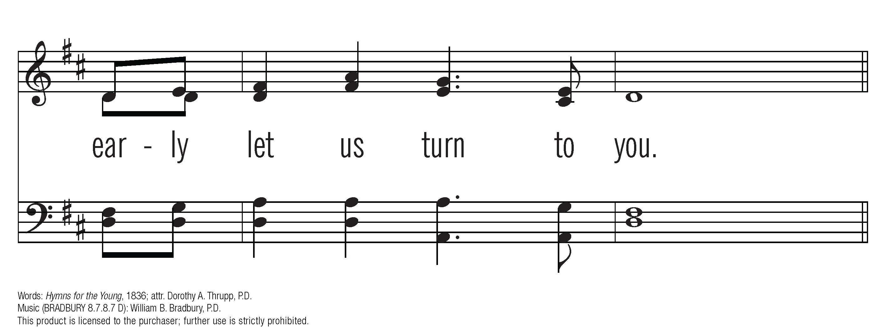
CCLI #678905

Slide 11
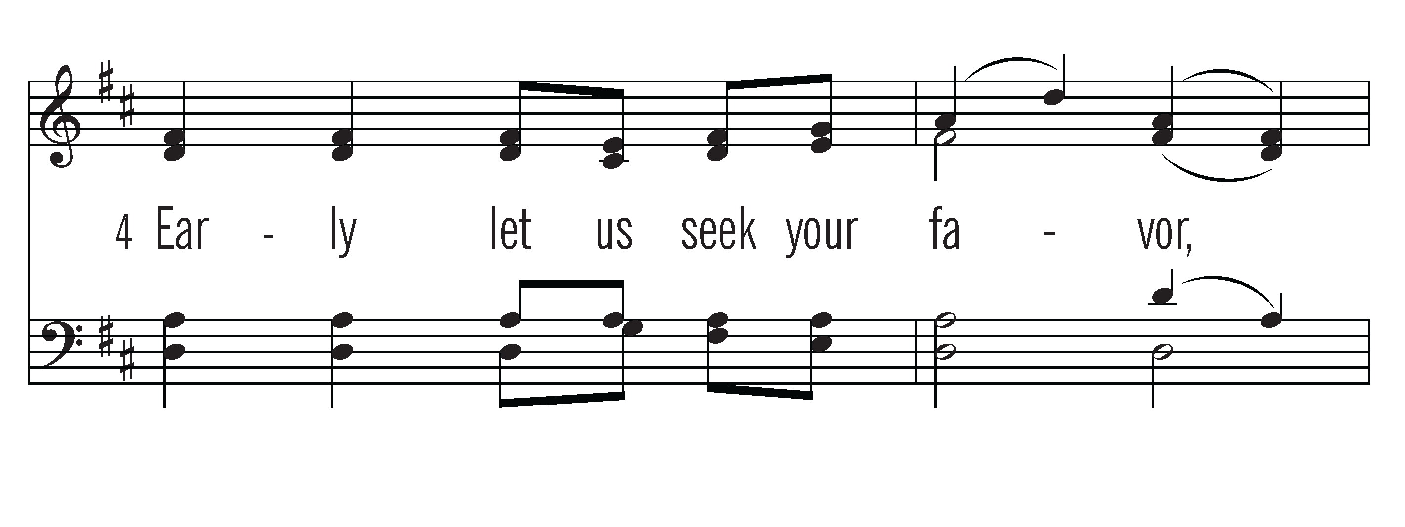
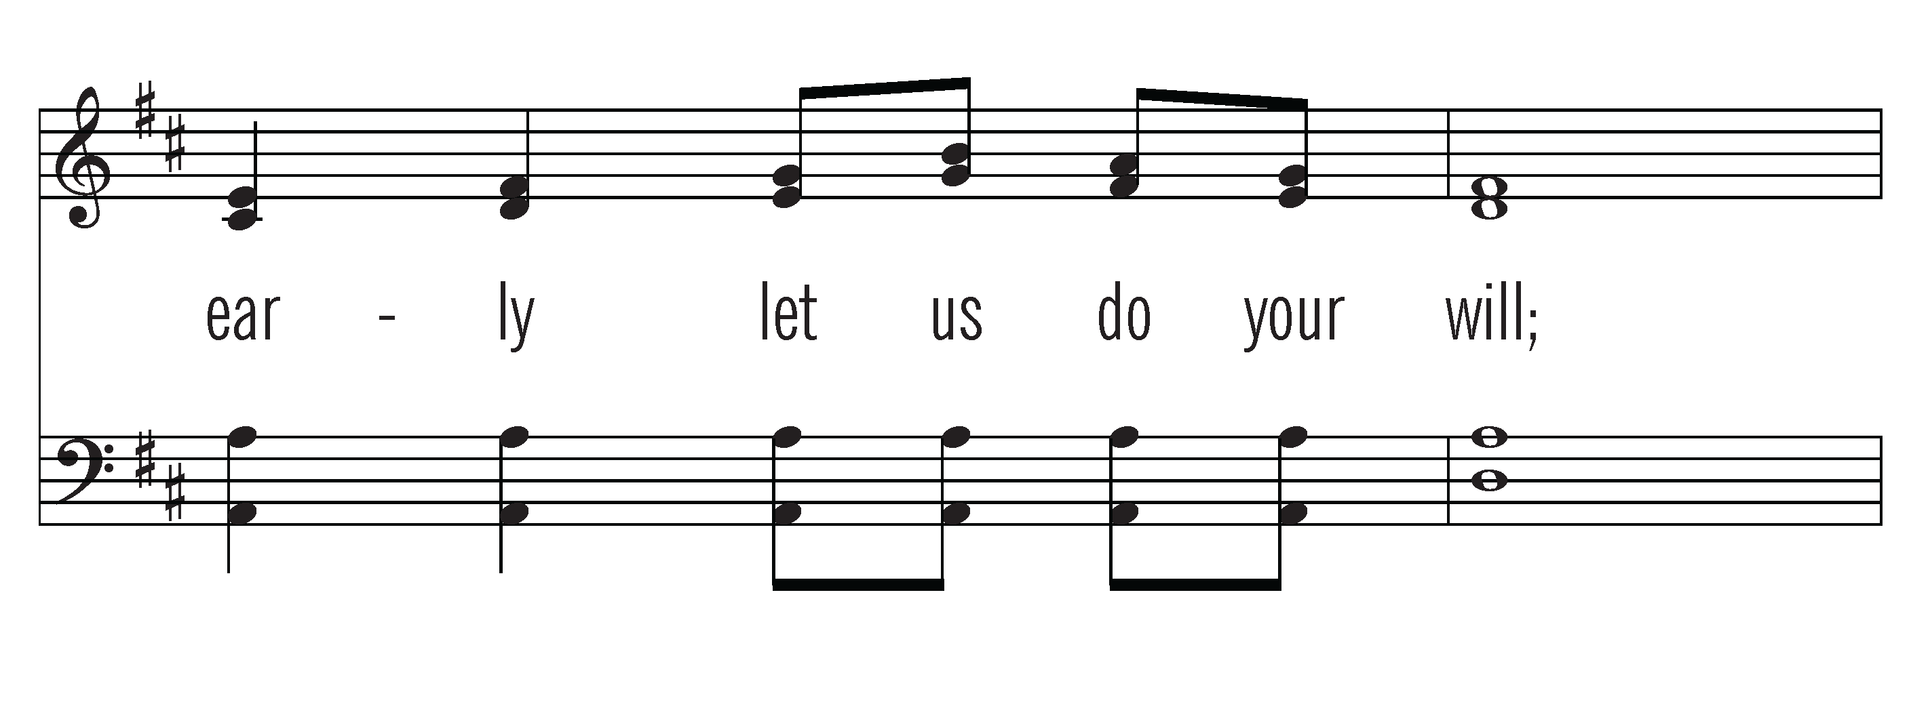

Slide 12
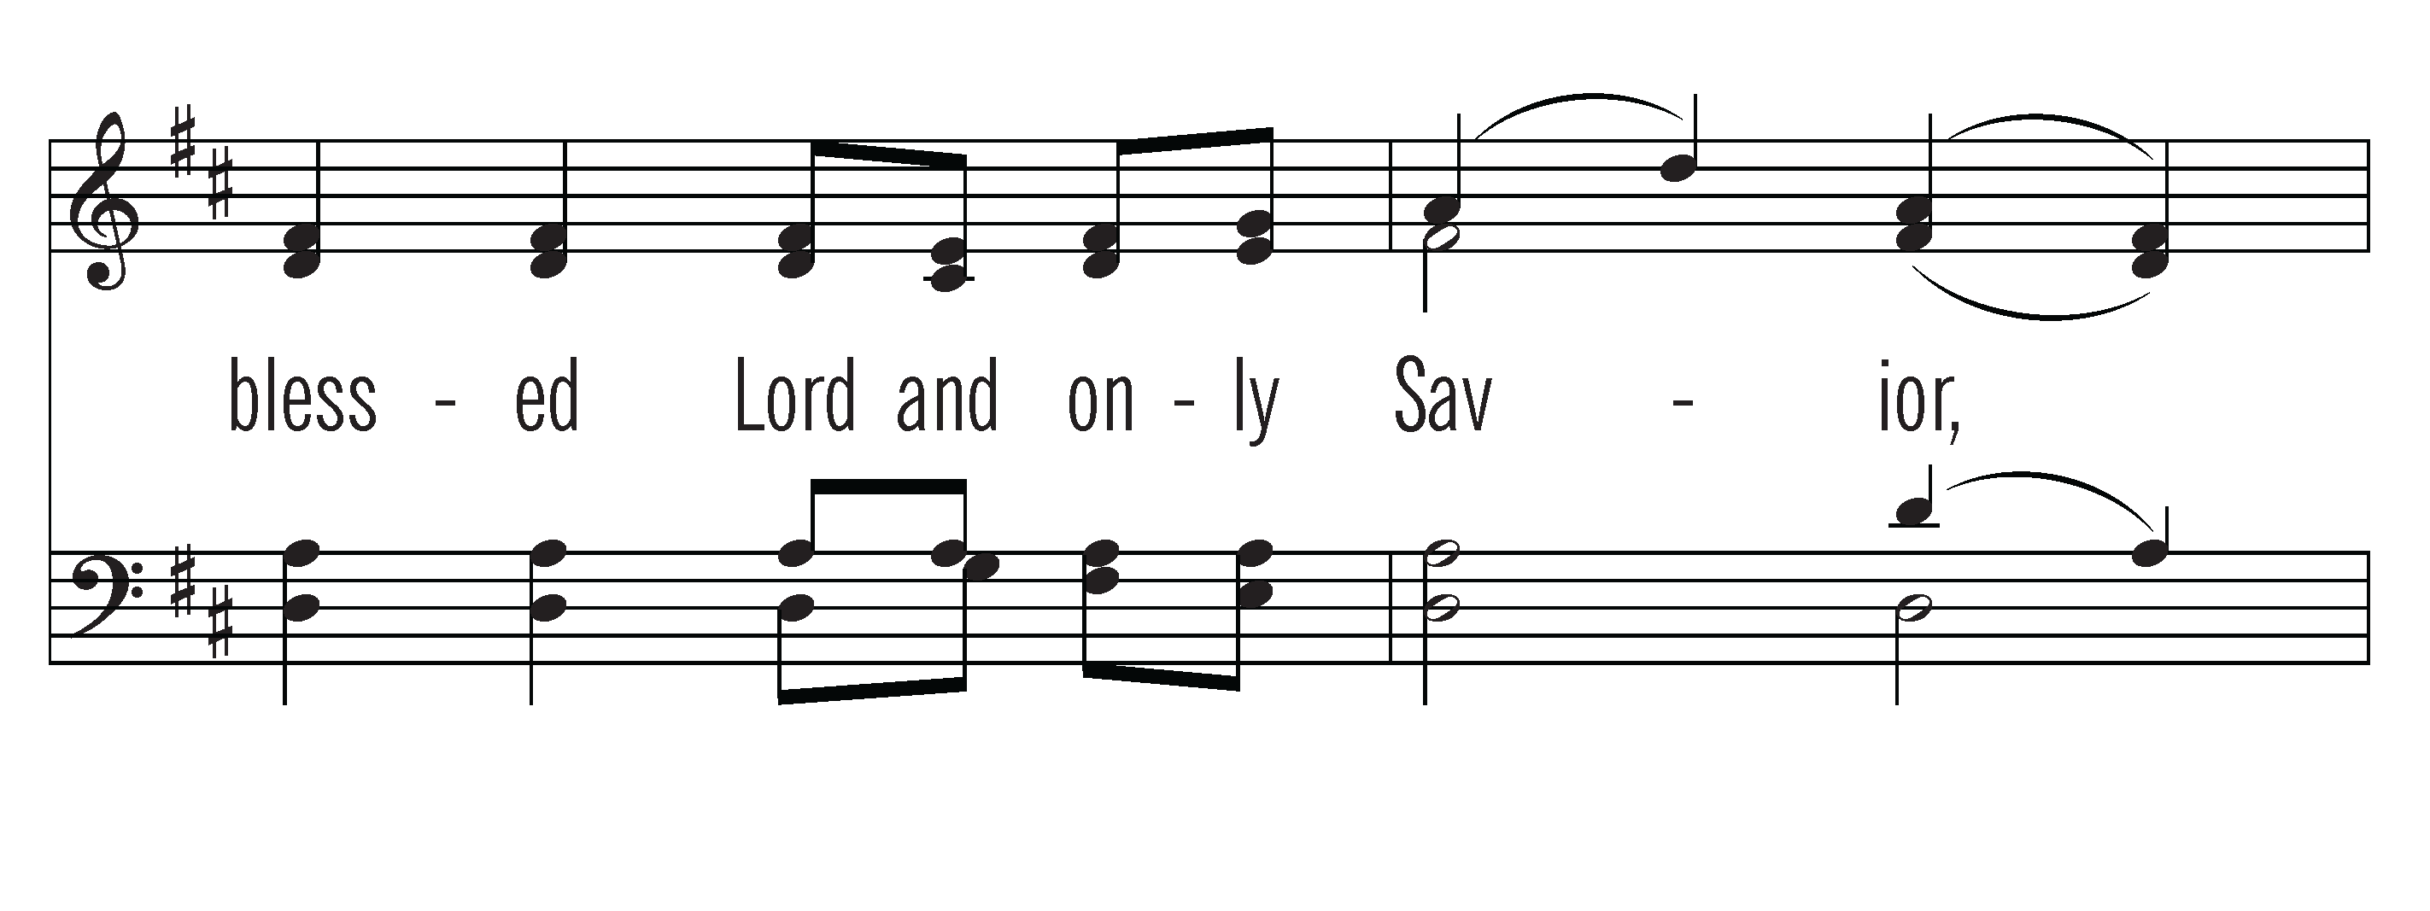
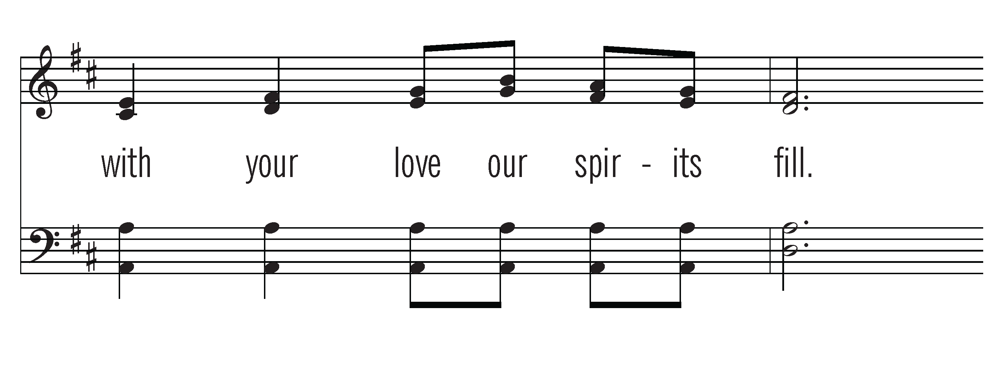

Slide 13
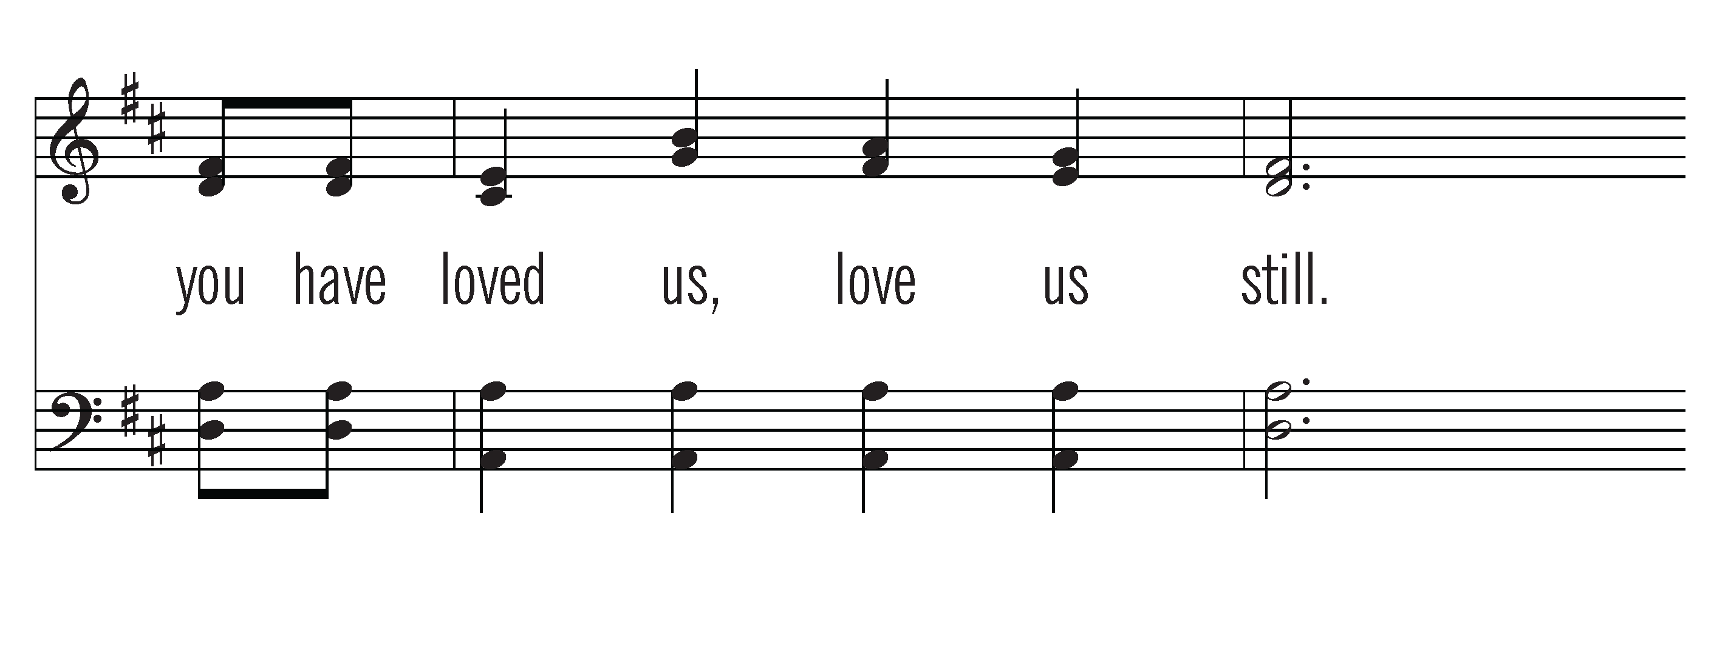

Slide 14
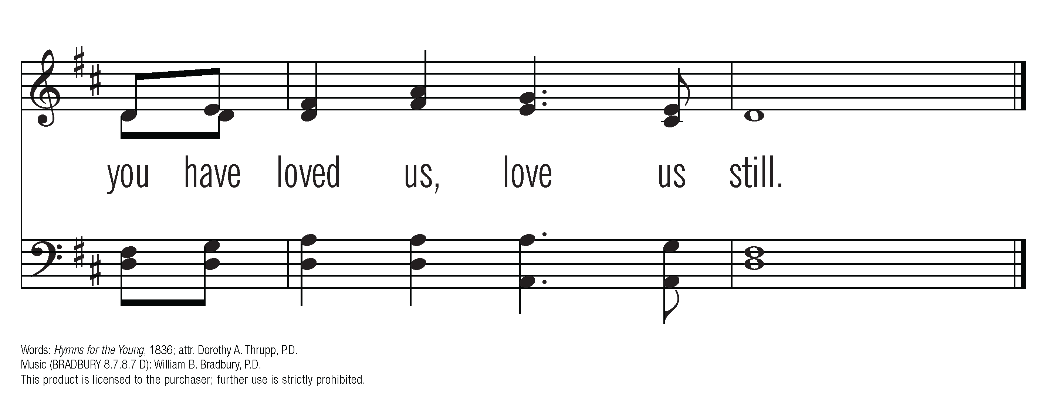
CCLI #678905

Slide 15
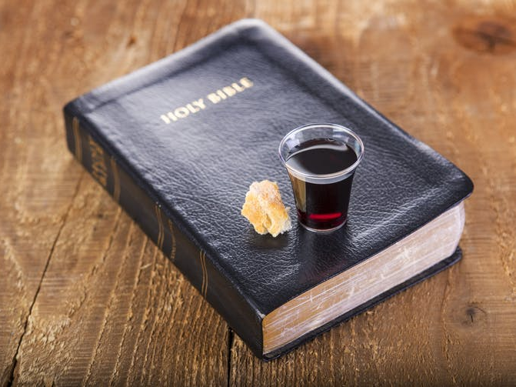
Welcome

Slide 16
Call to Worship
Leader: The Spirit gathers us to worship God and builds us up in faith,
hope, and love so that we may go into the world to proclaim the gospel and work for justice and peace.
People: Let us worship God together.

Slide 17
God’s Greeting:
Leader: The Lord be with you.
People: And also with you.
Leader: May the love of God the Father,
and the grace of Jesus the Son,
and the fellowship
of the Holy Spirit
be and abide with us all.
People: Amen!

Slide 18
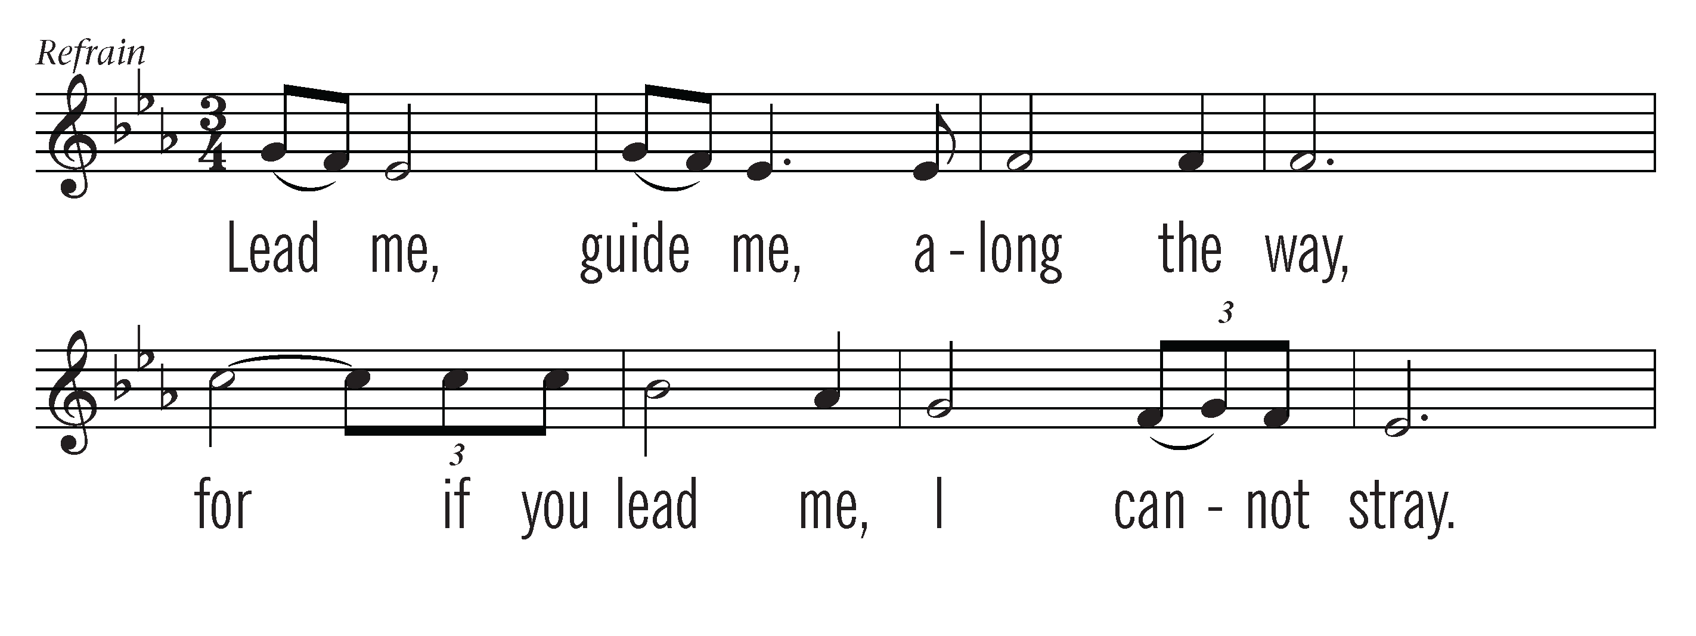
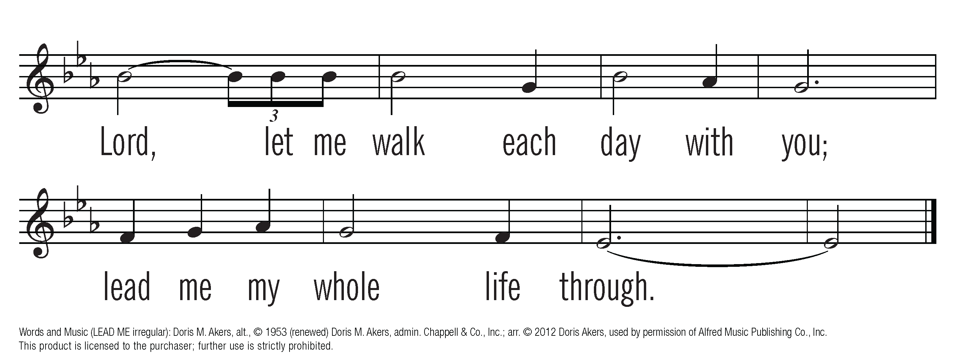
OneLicense.net License #A-711218

Slide 19
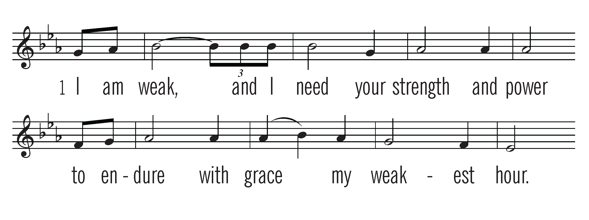
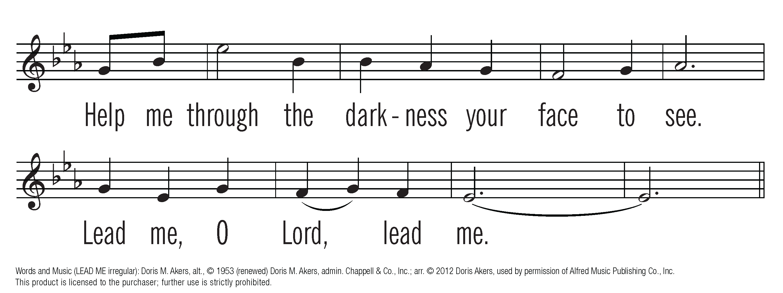
OneLicense.net License #A-711218

Slide 20


OneLicense.net License #A-711218

Slide 21
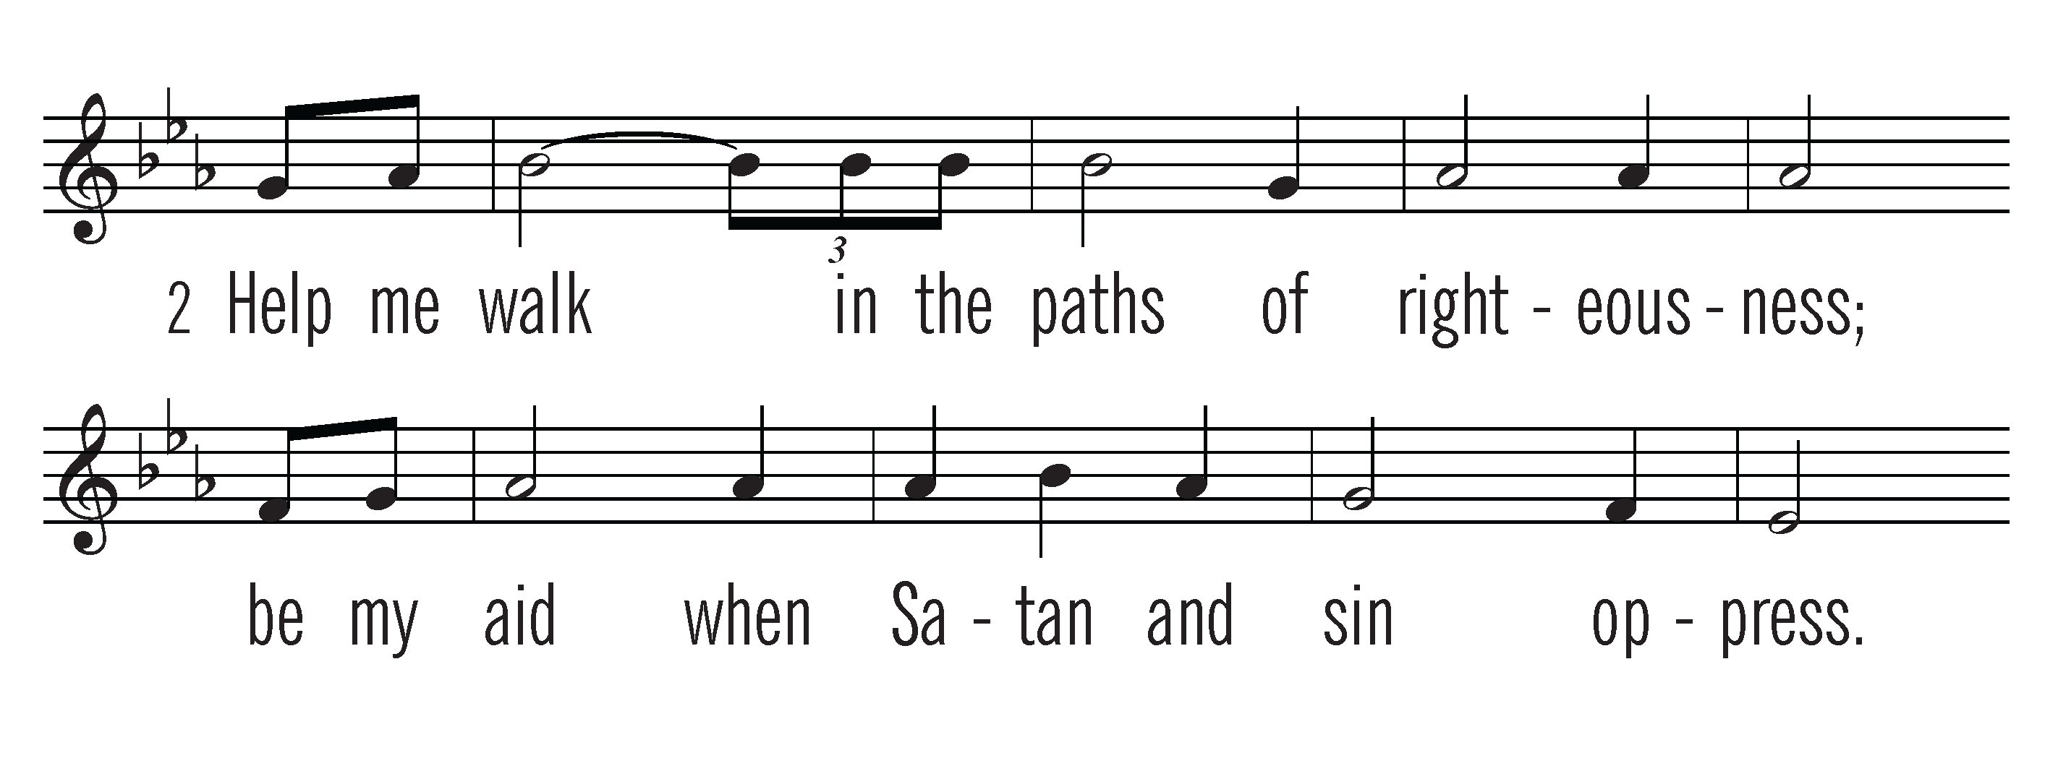
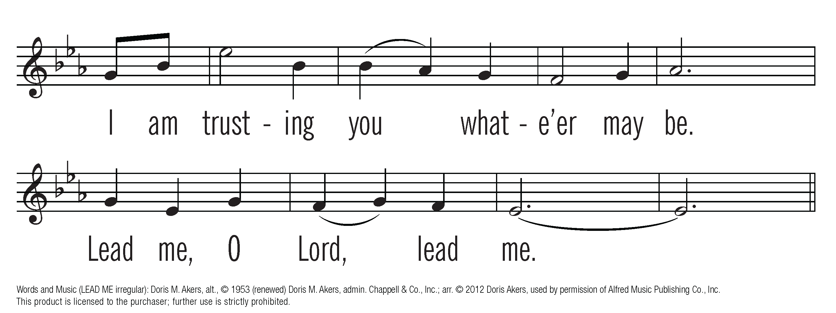
OneLicense.net License #A-711218

Slide 22
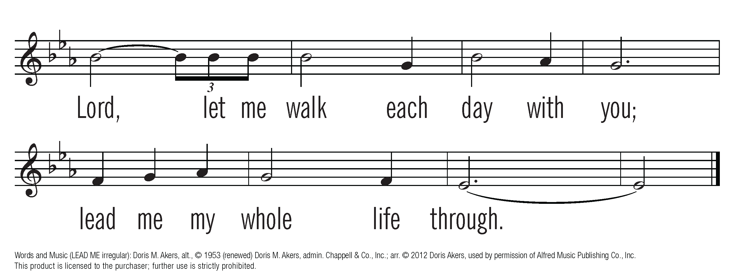
OneLicense.net License #A-711218

Slide 23
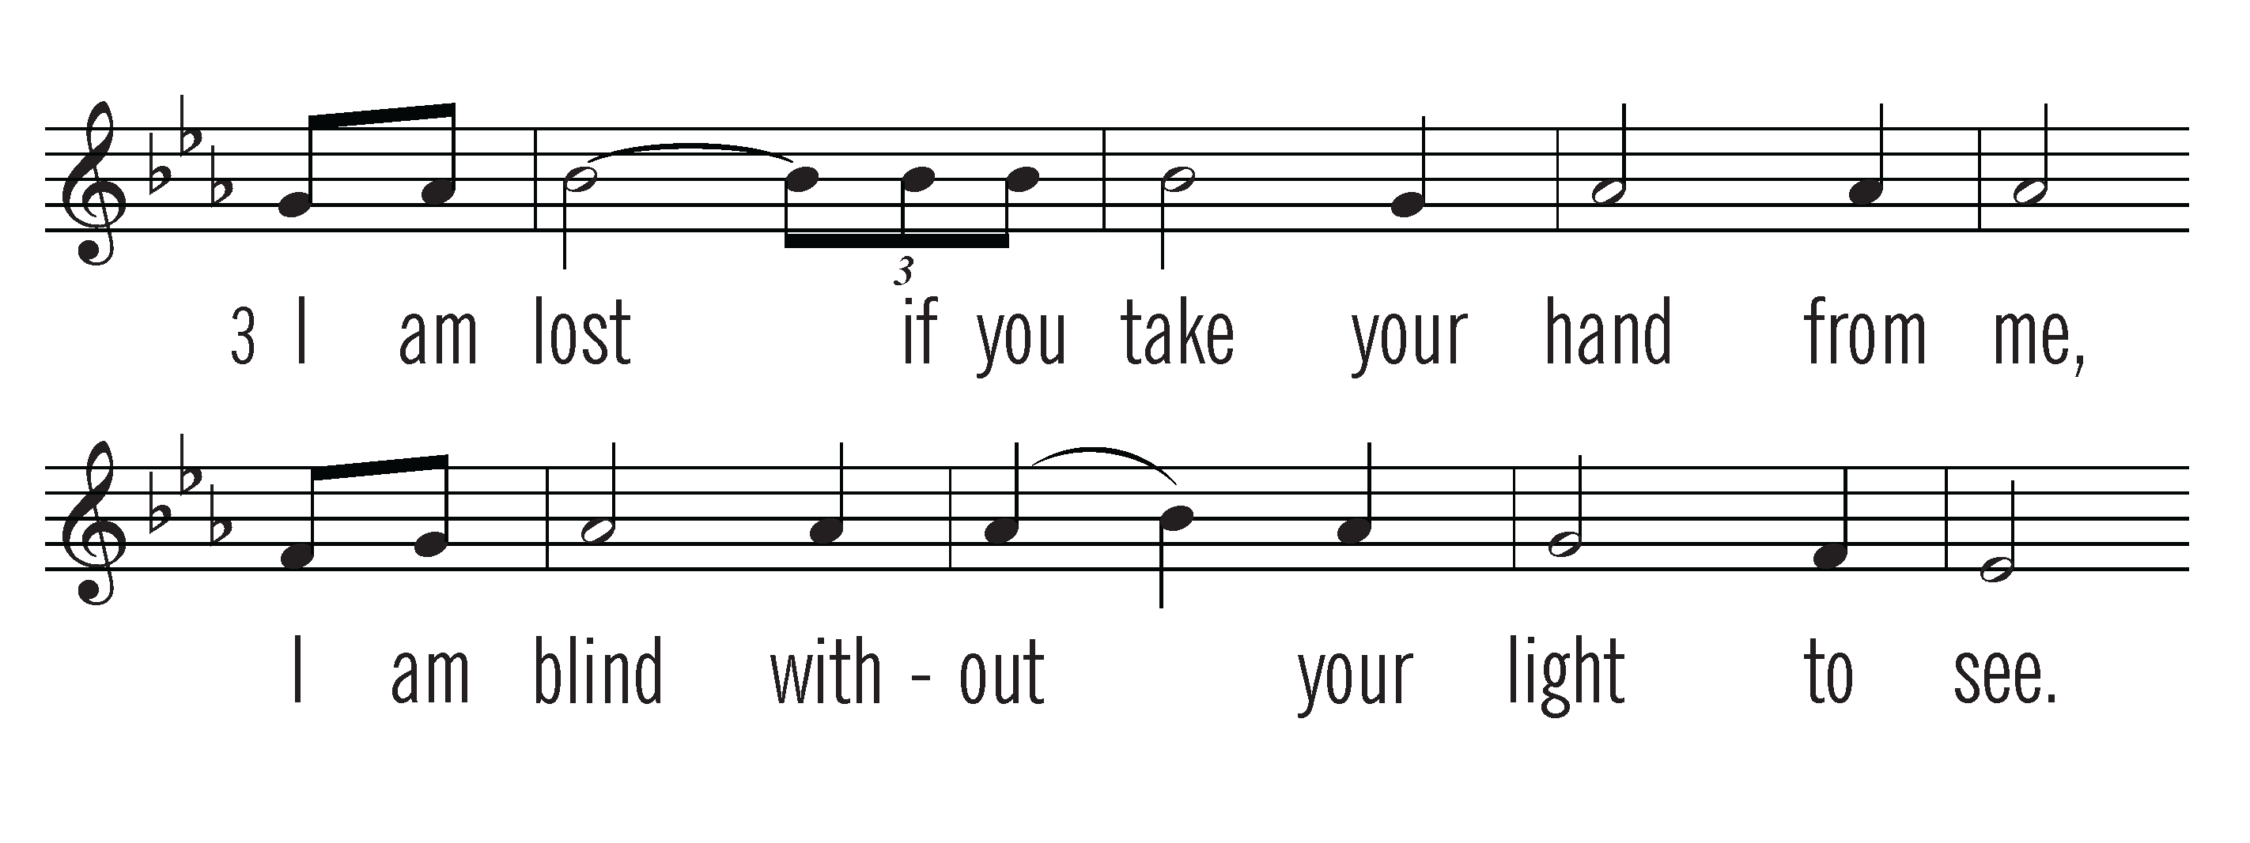
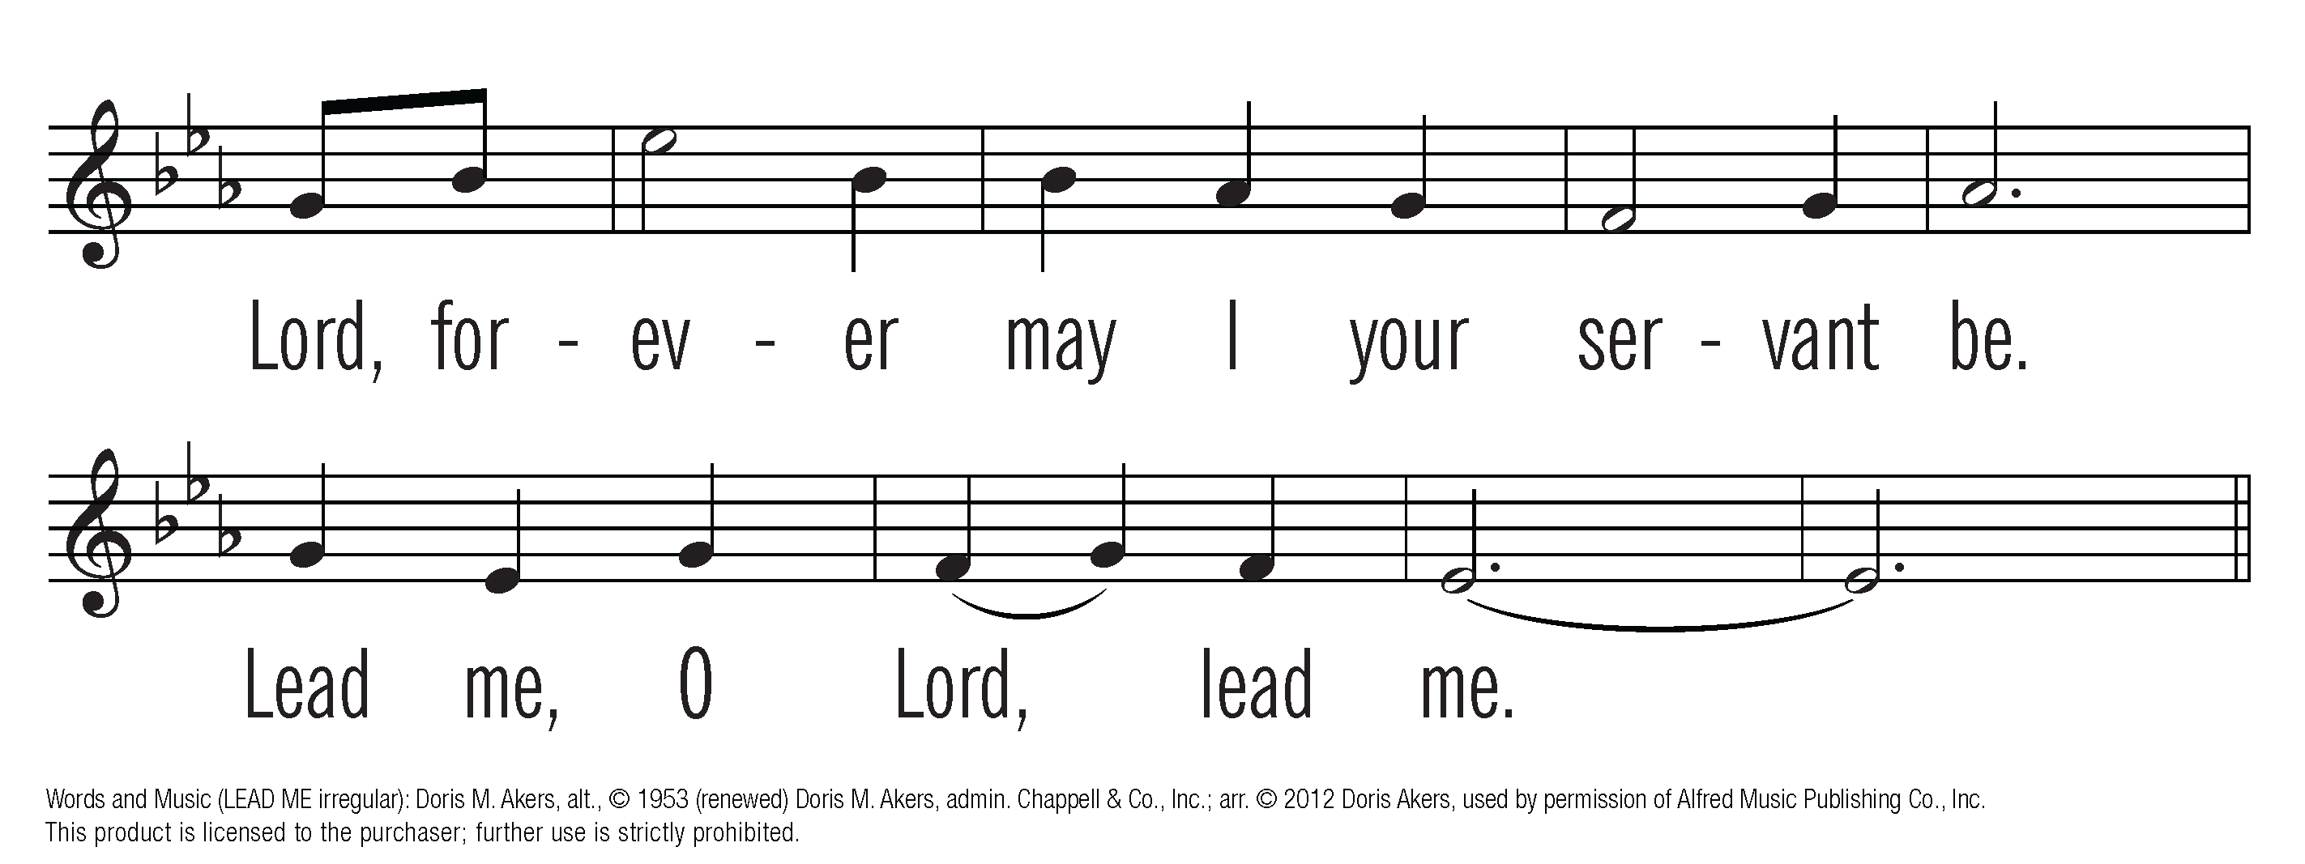
OneLicense.net License #A-711218

Slide 24
OneLicense.net License #A-711218

Slide 25
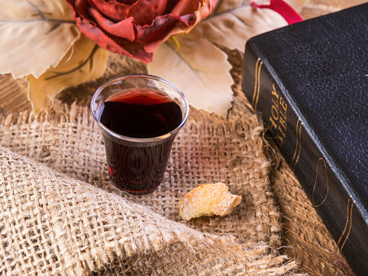
Announcements
O words with
heavenly comfort fraught!

Slide 26
Installation of New Elders & Deacons

Slide 27
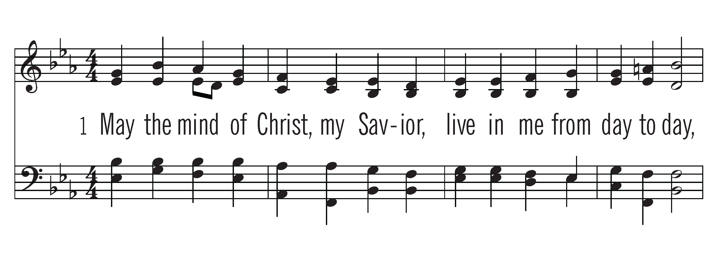
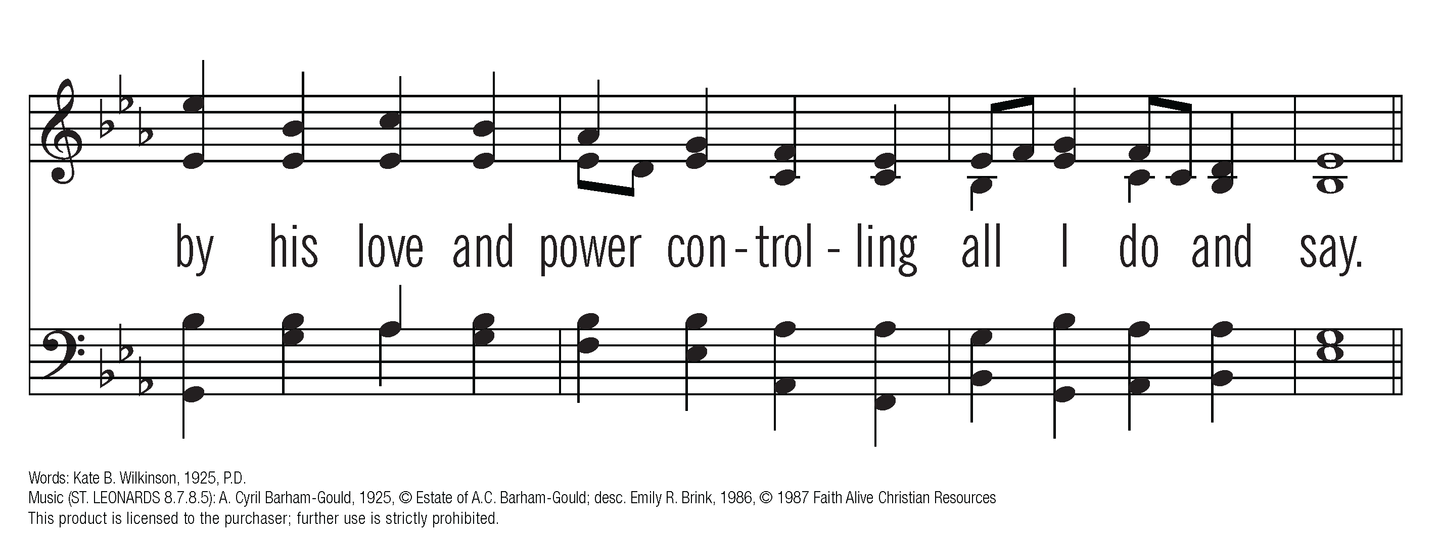
CCLI #678905

Slide 28
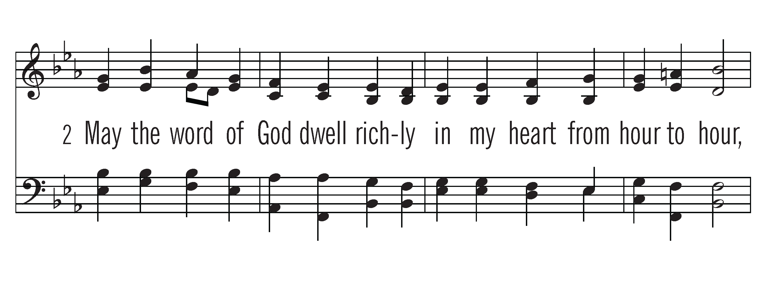
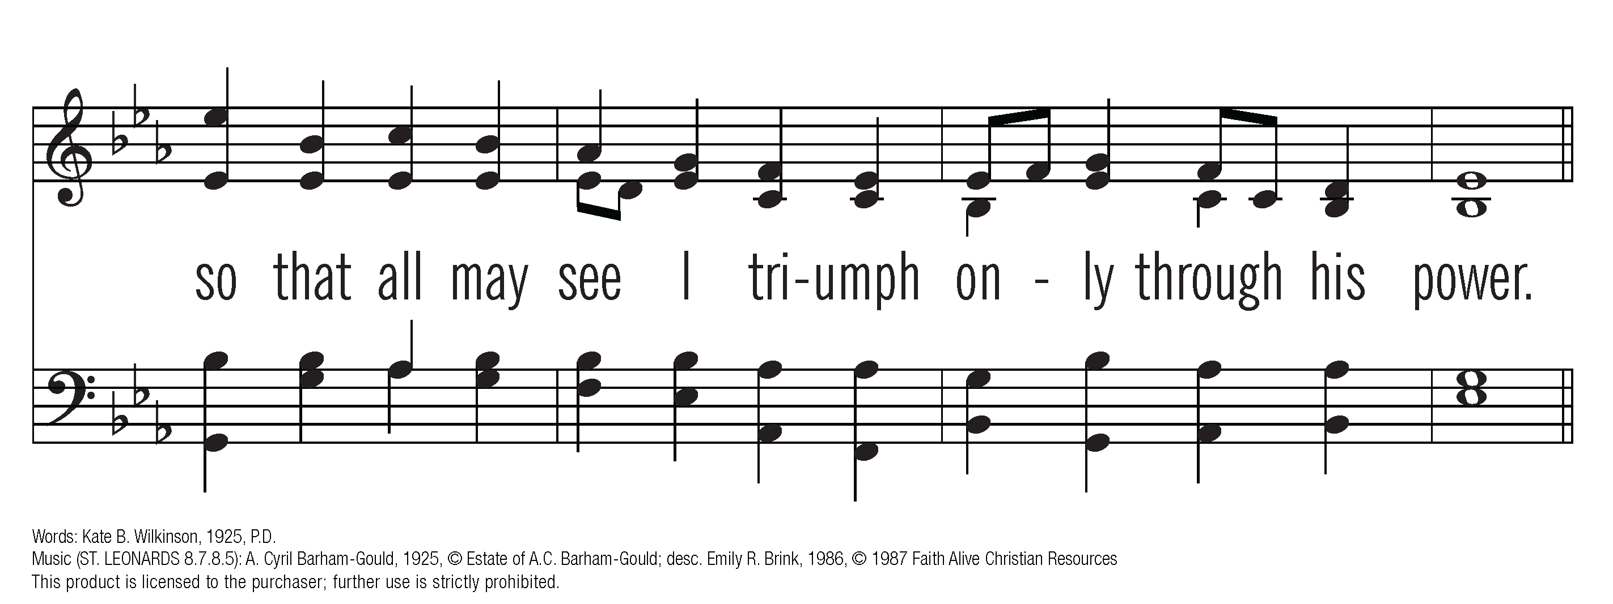
CCLI #678905

Slide 29
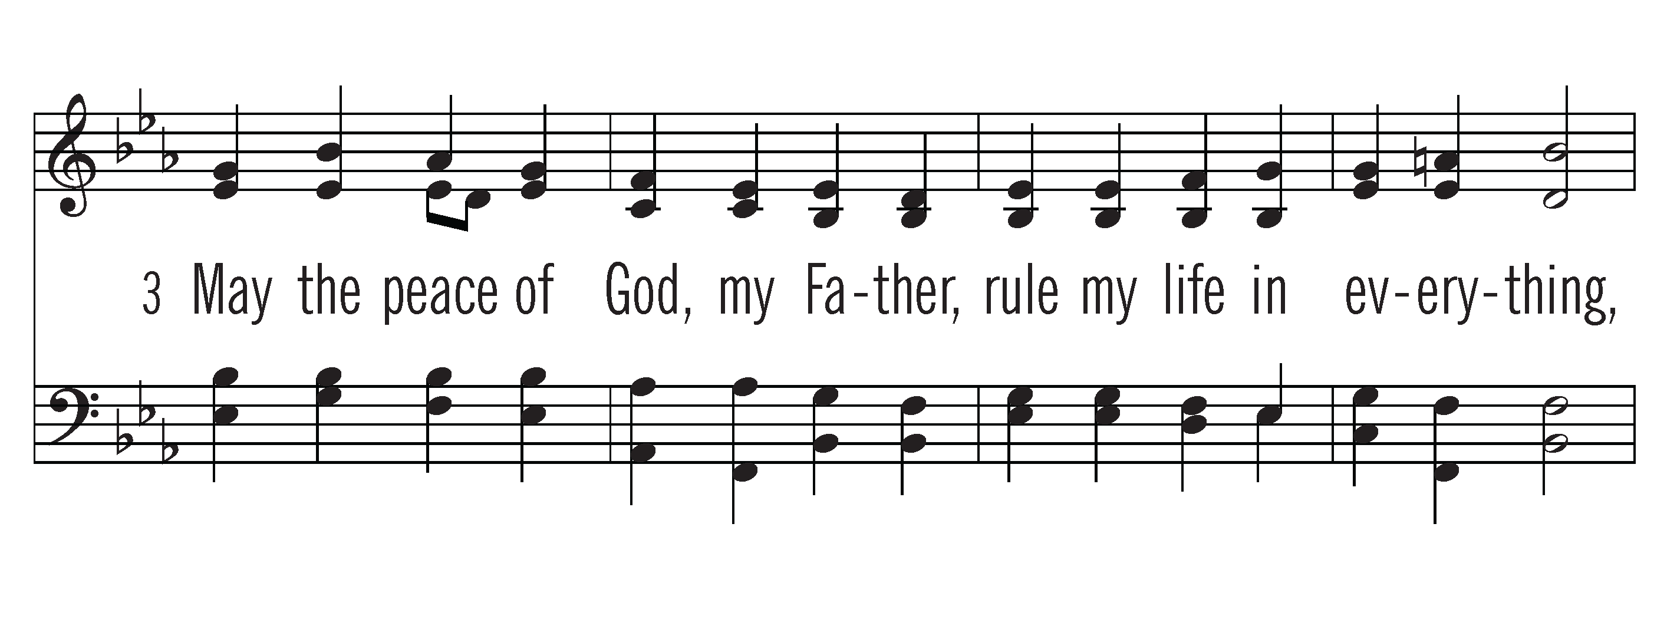
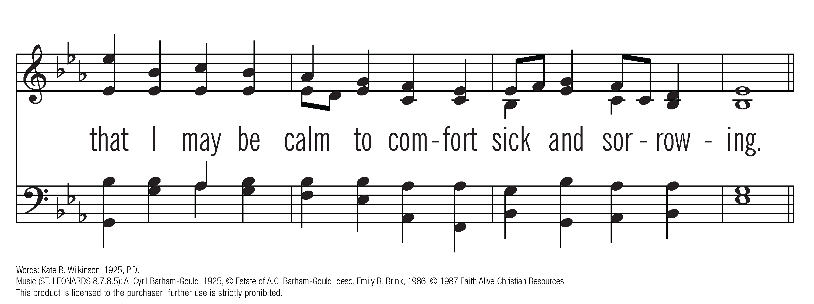
Acapella
CCLI #678905

Slide 30
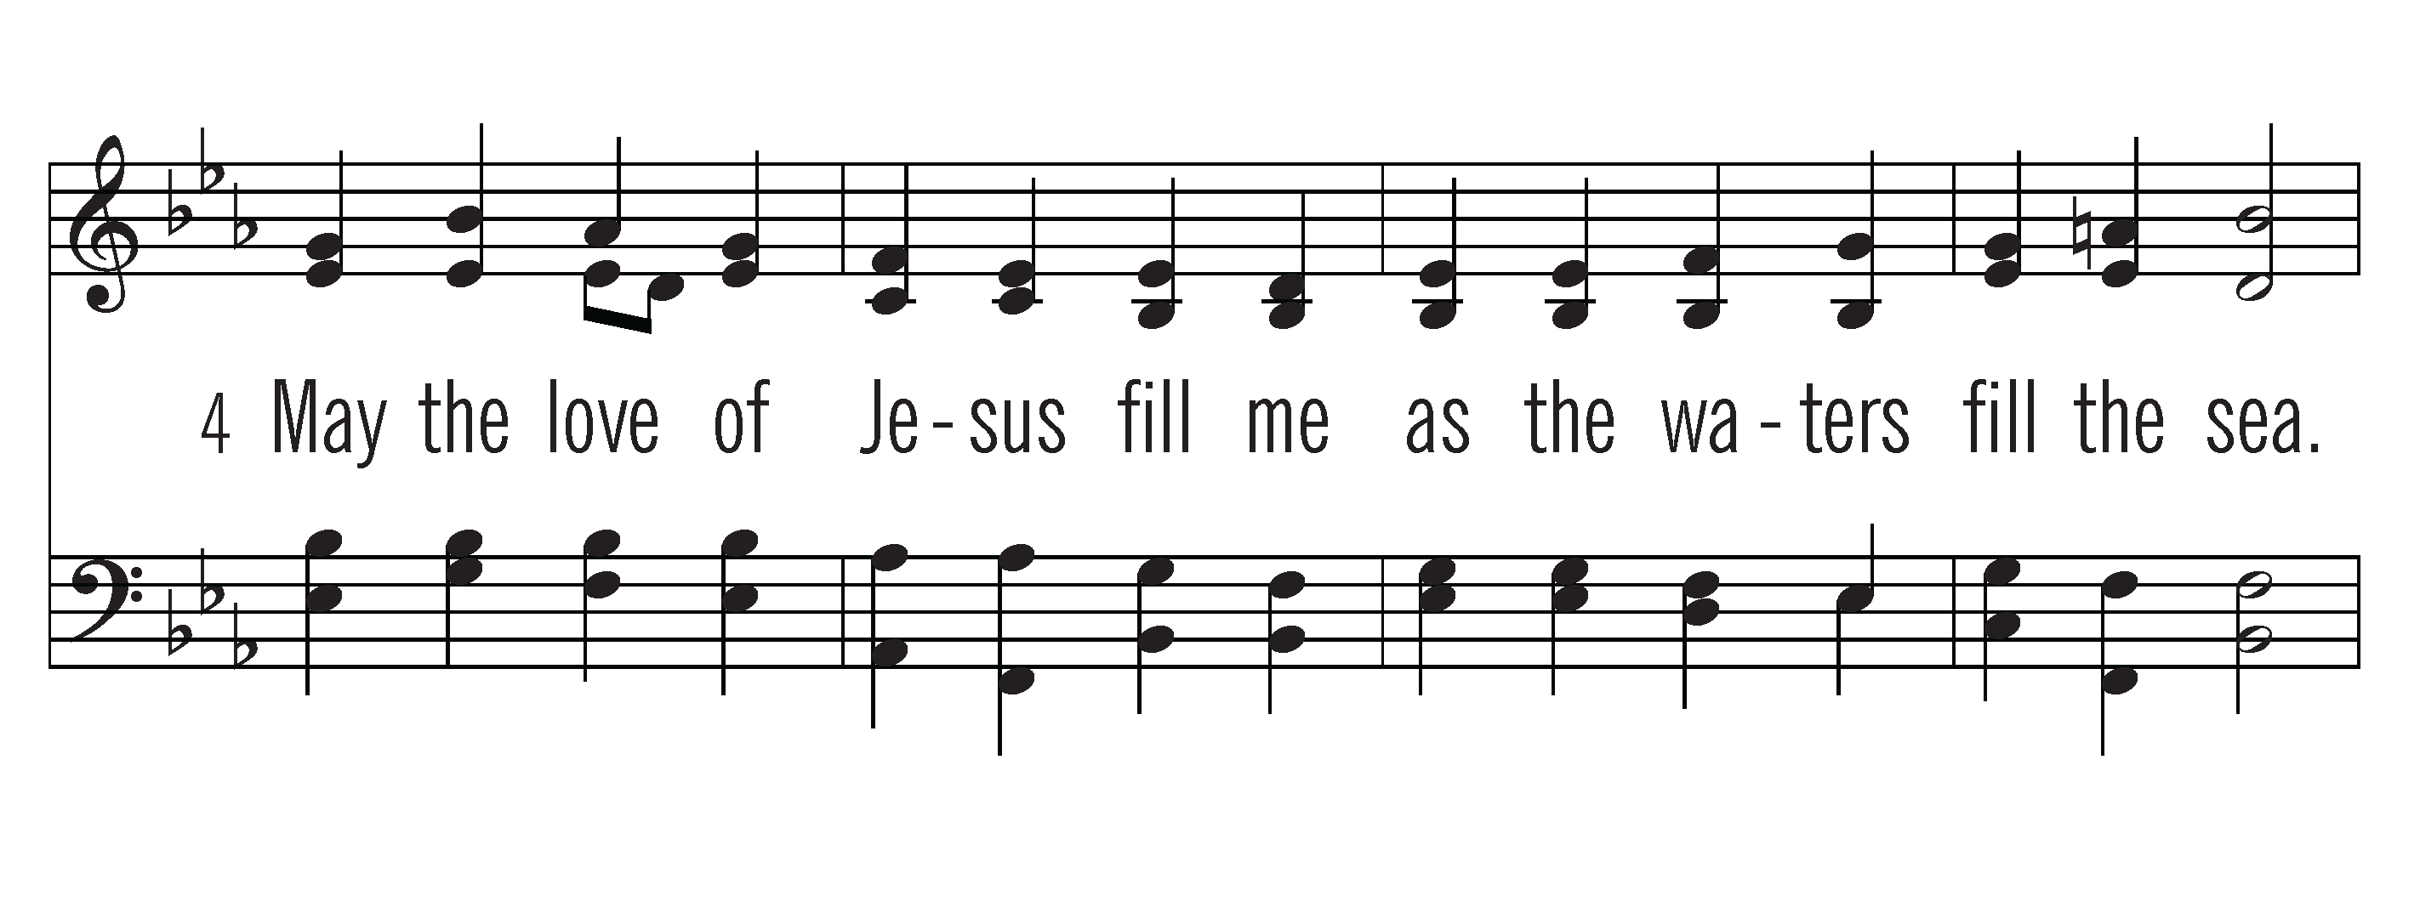
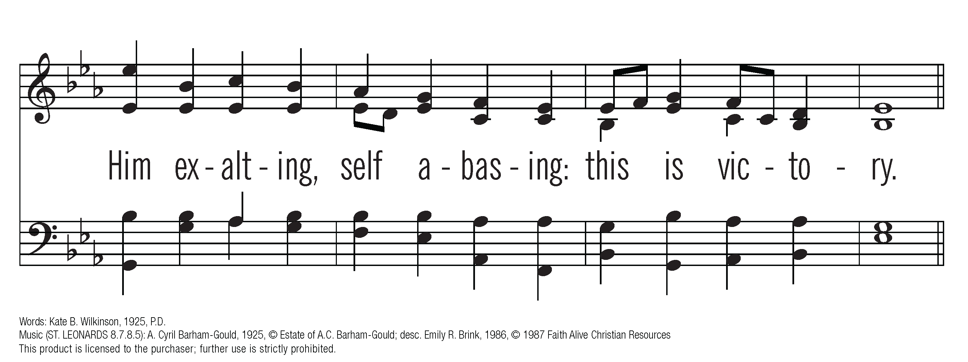
CCLI #678905

Slide 31
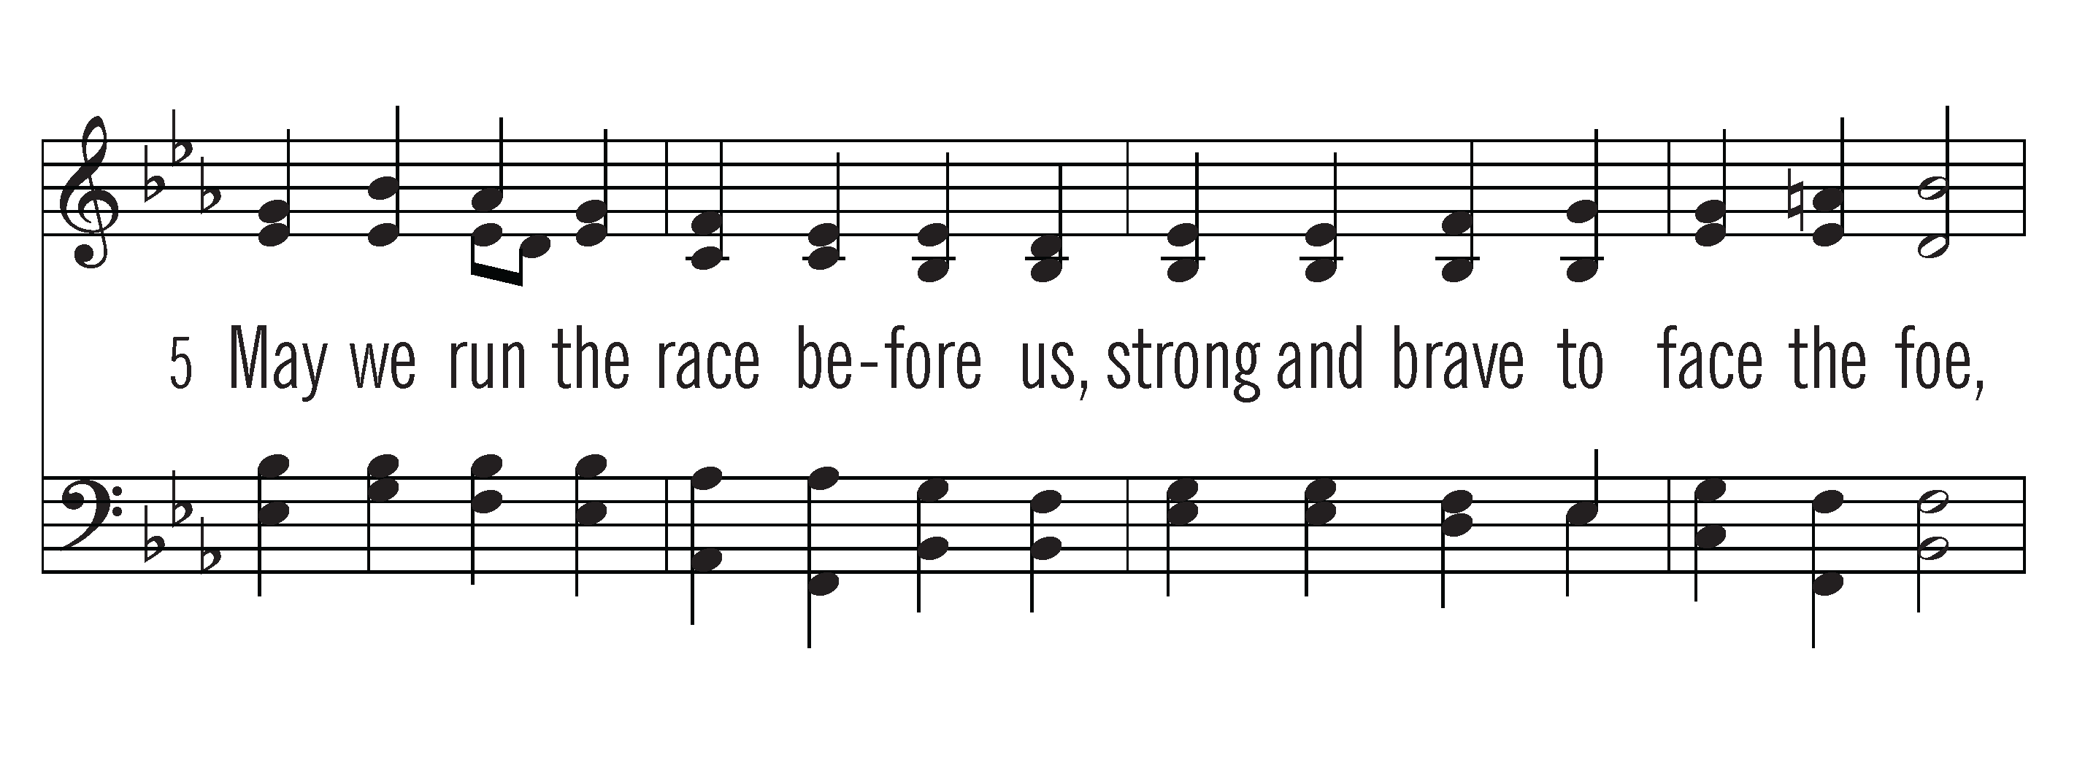
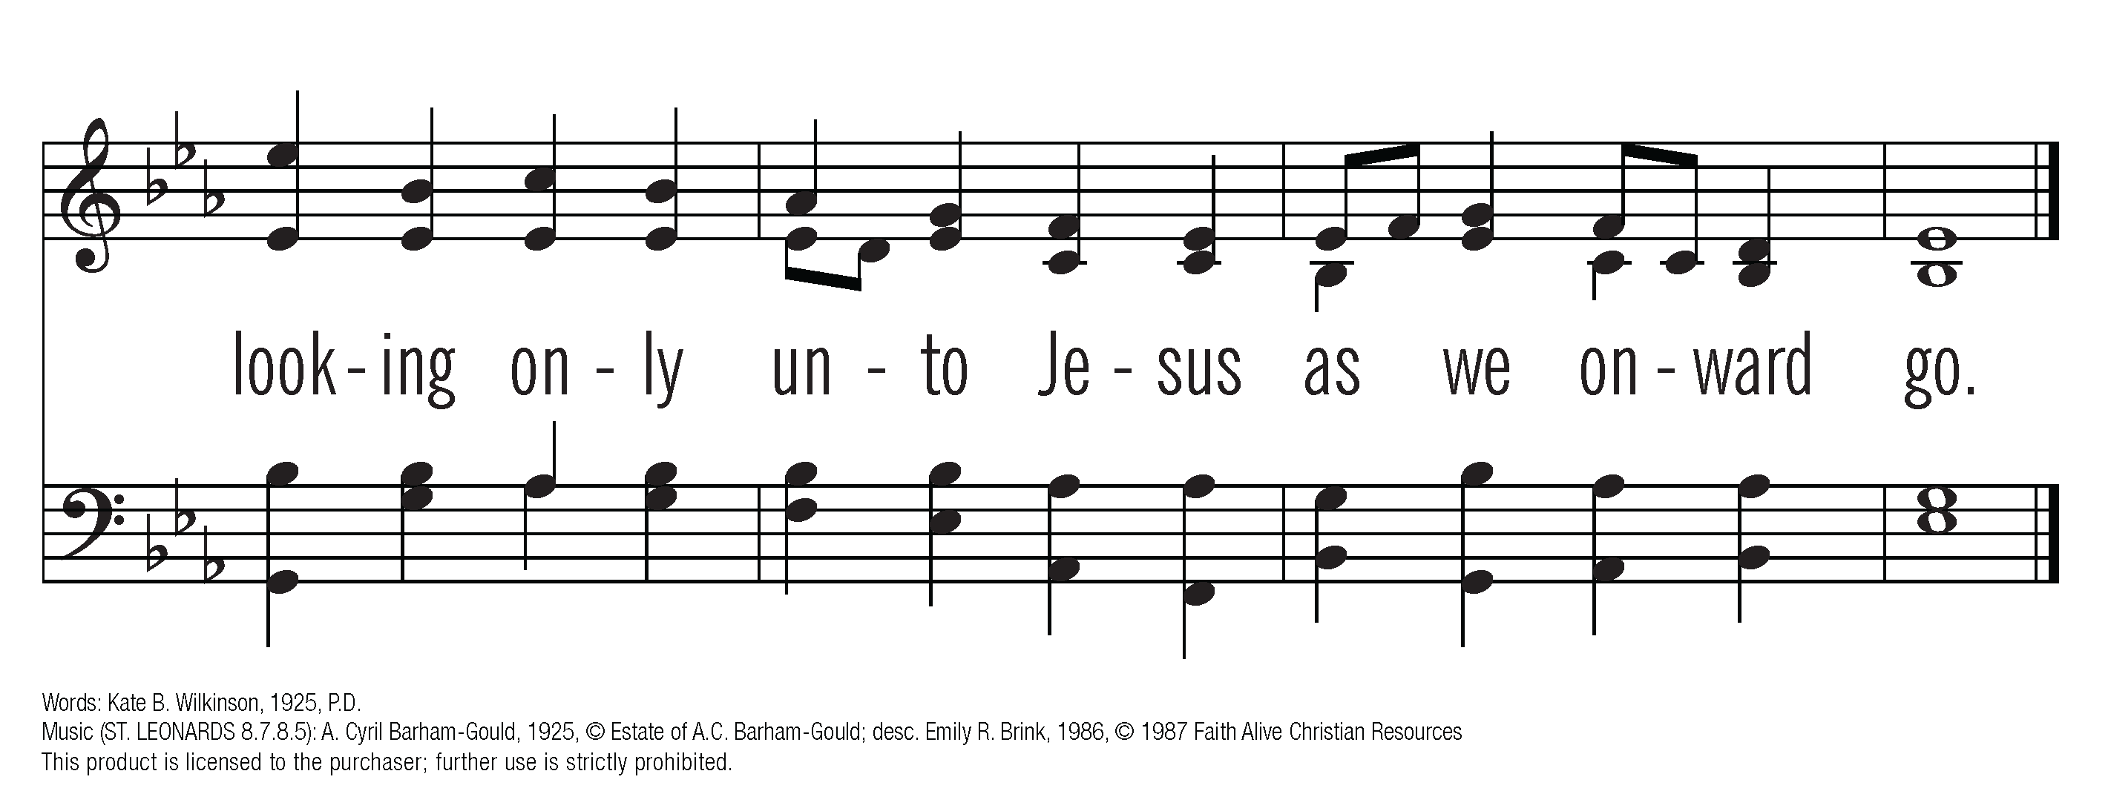
ACAPELLA
CCLI #678905

Slide 32
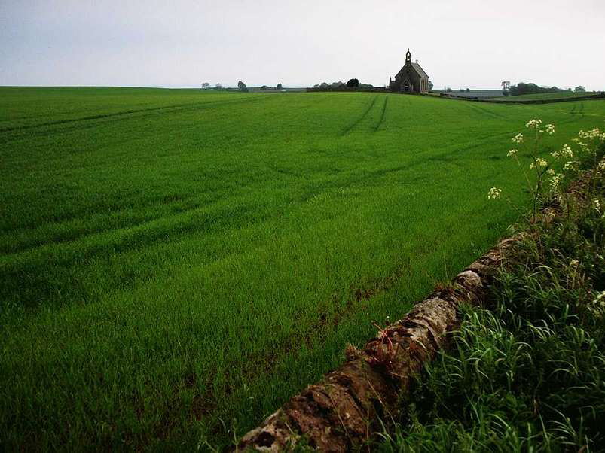
(At this time children ages 3 – 3rd grade
are excused for Children and Worship)
Whate’er I do, where’er I be

Slide 33
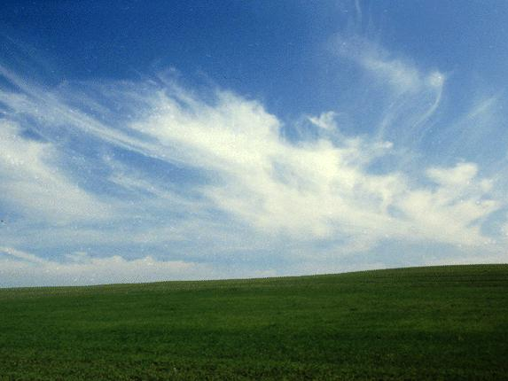
Scripture Reading: 1 Peter 4:1-6
¹Therefore, since Christ suffered in his body, arm yourselves also with the same attitude, because whoever suffers in the body is done with sin. ²As a result, they do not live the rest of their earthly lives for evil human desires, but rather for the will of God.

Slide 34
Scripture Reading: 1 Peter 4:1-6
³For you have spent enough time in the past doing what pagans choose to do—living in debauchery, lust, drunkenness, orgies, carousing and detestable idolatry. ⁴They are surprised that you do not join them in their reckless, wild living, and they heap abuse on you.

Slide 35
Scripture Reading: 1 Peter 4:1-6
⁵But they will have to give account to him who is ready to judge the living and the dead. ⁶For this reason the gospel was preached even to those who are now dead,

Slide 36
Scripture Reading: 1 Peter 4:1-6
so that they might be judged according to human standards in regards to the body, but live according to God in regard to the spirit.

Slide 37
Prayer of Illumination

Slide 38





Slide 39
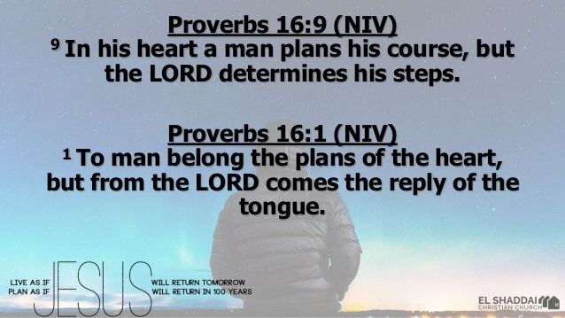

Slide 40
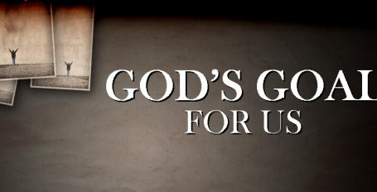

Slide 41
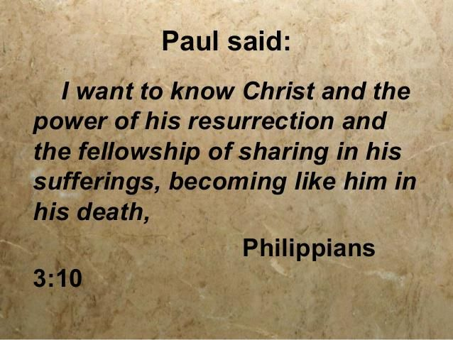
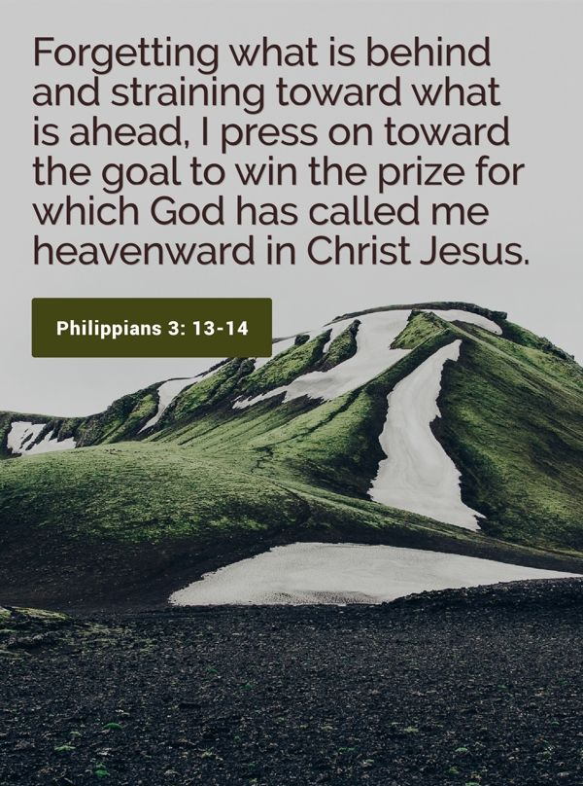

Slide 42
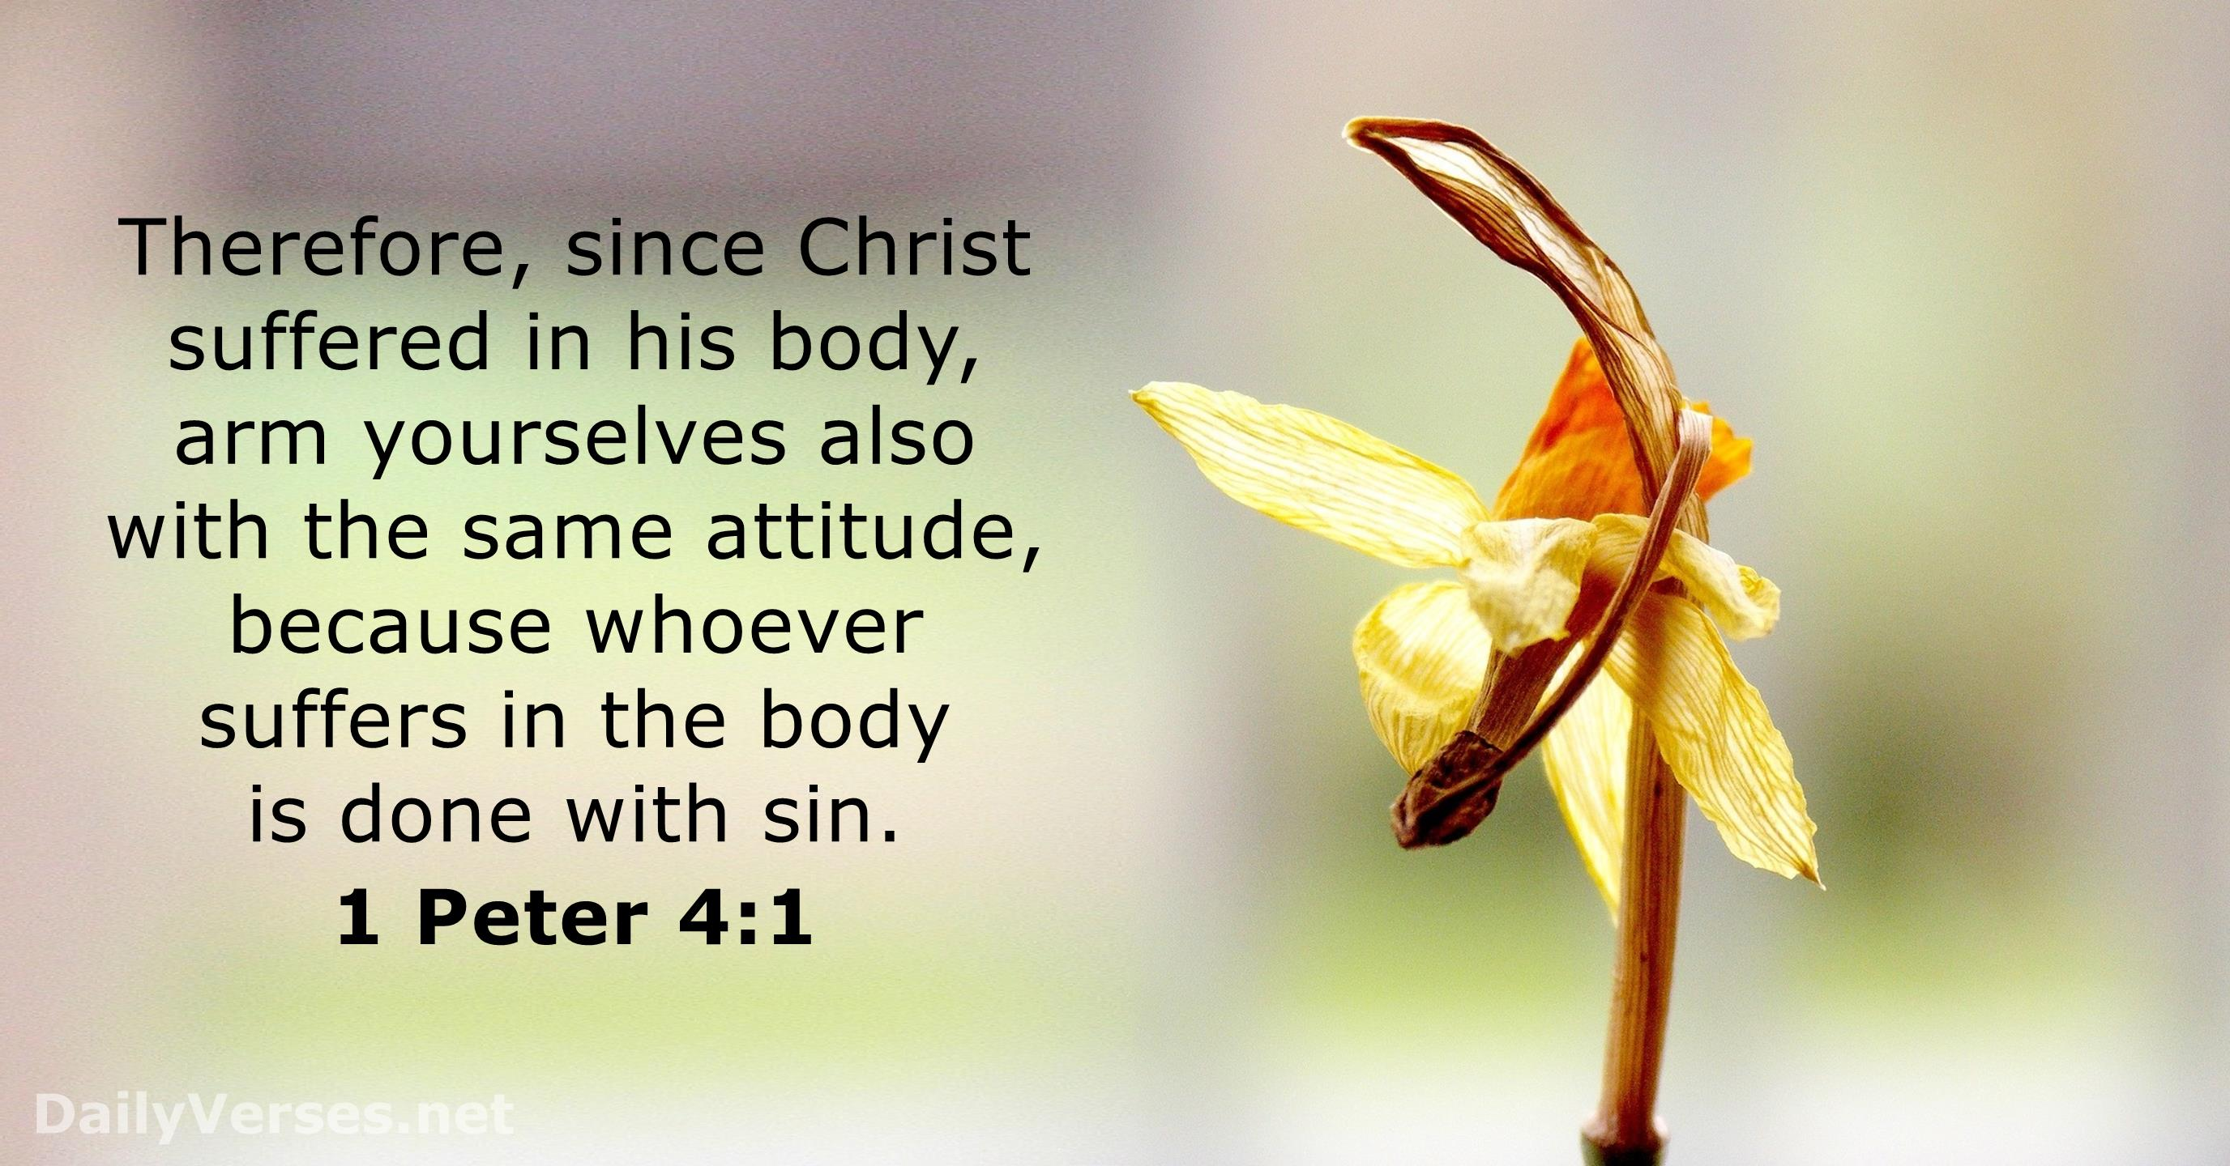

Slide 43


Slide 44


Slide 45


Slide 46


Slide 47


Slide 48


Slide 49


Slide 50


Slide 51


Slide 52



Slide 53

Time of Prayer
Still tis God’s hand
that leadeth me

Slide 54



Slide 55



Slide 56

CCLI #678905

Slide 57



Slide 58



Slide 59

CCLI #678905

Slide 60



Slide 61



Slide 62

CCLI #678905

Slide 63



Slide 64



Slide 65

CCLI #678905

Slide 66



Slide 67



Slide 68
CCLI #678905

Slide 71
CCLI #678905
During this song the children will be returning to the sanctuary and the elders serving communion are invited to come forward.

Slide 72
We Celebrate Communion Together

Slide 73
Summary of Scriptural Teaching

Slide 74
Prayer of Thanksgiving

Slide 75

Invitation and Distribution

Slide 76
Song of Reflection: He Leadeth Me

Slide 77

The Bread

Slide 78
The Cup

Slide 79
Prayer of Gratitude

Slide 80
We Profess our Faith: Our World Belongs to God st. 44-45
Leader: Following the apostles,
the church is sent –
sent with the gospel of the kingdom to make disciples of all nations, to feed the hungry, and to proclaim the assurance that in the name of Christ there is forgiveness of sin and new life for all who repent and believe- to tell the news that our world belongs to God.

Slide 81
We Profess our Faith: Our World Belongs to God st. 44-45
People: In a world estranged from God,
where millions face
confusing choices,
this mission is central
to our being,
for we announce the one name that saves.

Slide 82
We Profess our Faith: Our World Belongs to God st. 44-45
Leader: We repent of leaving this work to a few, we pray for brothers
and sisters who suffer for the faith,
and we rejoice that that the Spirit
is waking us to see our mission
in God’s world.

Slide 83
We Profess our Faith: Our World Belongs to God st. 44-45
People: The rule of Jesus Christ
covers the whole world.
To follow this Lord is to serve him everywhere, without fitting in,
as light in the darkness,
as salt in a spoiling world.

Slide 84
God’s Blessing

Slide 86
CCLI #678905

Slide 88
CCLI #678905

Slide 90
CCLI #678905

Slide 92
CCLI #678905

Slide 93
Postlude
Have A Blessed Week!

